Slide 1
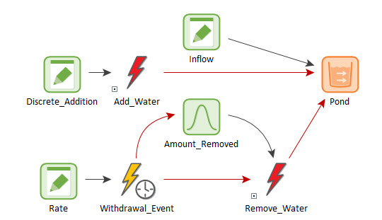
Representing Discrete Changes in Water Management Models
Rick Kossik

Slide 2
What Do We Mean by a “Discrete Change”?
Dynamic behavior can be conceptualized in two different ways: continuously or discretely.
Things that move continuously can be thought of as flowing (e.g., water).
Other things move or happen discretely. Examples of this include financial transactions, turning on or off a pump, equipment failures and accidents.
Just because something is considered to flow (like water), it does not mean that all of the dynamics for that system can be treated as being continuous. For example, if water is flowing from one pond to another (via a pump), and the pump suddenly breaks down, that is a “discrete change” that changes the system state, and must be treated in an appropriate manner.
As a result, most real-world systems are best described using a combination of continuous and discrete dynamics (i.e., hybrid systems).

Slide 3
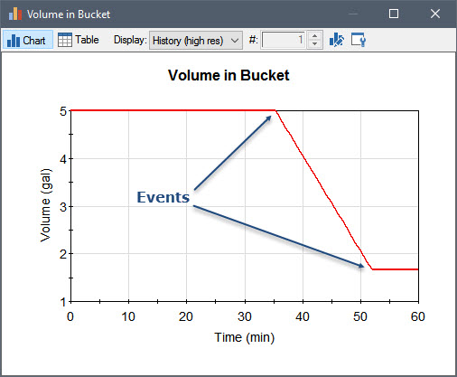
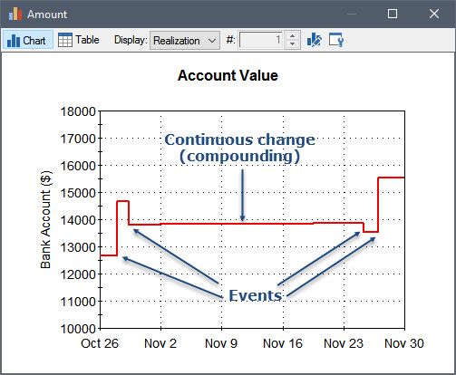
Examples of Discrete Changes
Note: Definition of “instantaneous” is relative

Slide 4
Representing Events in GoldSim
To model discrete changes to a system, we need to represent “events”
You can generate events in GoldSim in four different ways:
Based on a specified rate of occurrence, which can be treated as regular or random ("occur exactly once a week" or "occur, on average, once a week");
When a specified condition (e.g., Water_Level > 10m) becomes true or false;
When a specified output in the model changes; or
At a specified calendar or elapsed time.
Events can then be specified to instantaneously trigger various elements to take a particular action (e.g., instantaneously change their value).

Slide 5
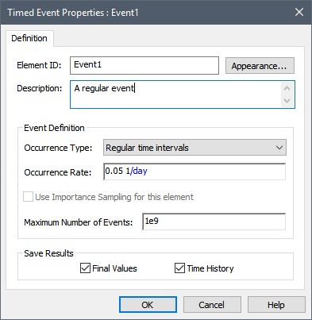
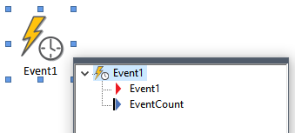
Generating a Timed Event
Let’s create an event that occurs once every 20 days
We use the Timed Event element to do this

Slide 6
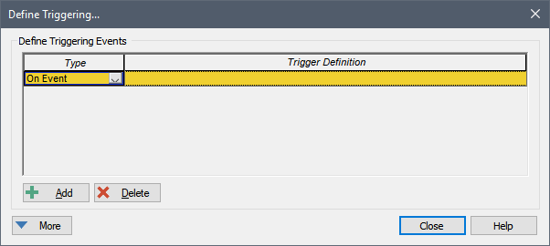
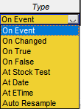
Understanding Triggering
In order for events to be consequential, they must trigger other elements
All elements that can be triggered share the same triggering dialog

Slide 7
Some Simple Triggers
Triggering a Stochastic using a Timed Event
Some events insert an unscheduled timestep
Triggering a Stochastic using a condition
Recall you can generate an event when a specified condition (e.g., X > Y) becomes true or false
Triggering multiple element simultaneously using a Triggered Event element

Slide 8
Responding to an Event: Changing a Quantity
A variety of GoldSim elements can be triggered by events, with each element responding to the event (taking a particular action) in a different manner.
We just looked at one such element, the Stochastic
One of the most powerful (and common) ways a model can respond to an event is to cause a discrete (i.e., sudden) change to a quantity. This is commonly done for water management models.
Quantities are state variables
Generally represented by a Stock element (Reservoir, Pool, Integrator)

Slide 9
Changing the Volume in a Pond
Start with a pond (with a constant inflow and an evaporation rate)
Let’s assume that what we want to simulate is someone adding (instantaneously) 25 m3 of water at 65 days.

Slide 10
Complex Triggers
Start Time of 1/1/2018, an End Time of 1/1/2019, and a one-day timestep.
A pond starts empty and has a constant inflow rate of 1 m3/day.
There is a discrete addition of 60 m3 every month.
There is a discrete withdrawal that occurs randomly once every 50 days, but only in July through December (the withdrawal does not occur January through June).
The amount withdrawn is sampled from a Normal distribution with a Mean of 200 m3 and a Standard Deviation of 40 m3.

Slide 11
Responding to an Event: Changing the State of a System
In many models, the state of the system changes discretely (suddenly) during a simulation in a binary manner:
A piece of equipment fails (i.e., changes its state from operating to failed)
An object (e.g., a pump or a light) turns on or off
A facility starts operating and stops operating
It is useful for the state of the system to then be referenced by other elements
To support this, GoldSim provides two elements that can be used to track the state of the system: the Status element and the Milestone element.
Both of these elements can respond to discrete signals.

Slide 12
Status Element Example
Simulate a conveyor belt that moves soil from one location to another, where it is subsequently stockpiled.
The conveyor belt is modeled using a Material Delay. The stockpile at the end of the conveyor belt is a Reservoir.
When the conveyor belt is operating, it moves at a constant rate and is loaded at a contant rate.
The conveyor belt, however, only operates from 8AM to 5PM. Outside of that time, the conveyor belt stops (and is no longer loaded).
The model uses a Status element to track the state of the conveyor belt (on or off).

Slide 13
Milestone Element Example
We want to record when the stockpile gets to a certain size (e.g., 20,000 kg). Moreover, at that point we want to shut down the entire process.
We will use a Milestone element to represent this.

Slide 14
Using Status Elements for Feedback Control
Status elements can be used to properly model a feedback control system
In the absence of Status elements, it is common to see models that result in (unrealistic) oscillations
This is one of the most common problems we see in water management models
Let’s experiment with a simple example:
A pond starts empty
Stochastic Inflow represented by a truncated Normal, with Mean 100 m3/day, SD of 50 m3/day, Min of 0 m3/day (changes hourly)
We want to try to keep the volume at 300 m3 by using a pump that operates at 200 m3/day
What should our logic be for turning on and off the pump?

Slide 15
Using Status Elements for Feedback Control (cont.)
This is not representative of how a real feedback control system would typically work.
As an analogy, consider a thermostat:
A thermostat monitors the temperature (a proxy for the heat in the house, which is the state variable)
The heat does not turn on when temperature drops below X and turn off when it reaches X
Rather, it uses a deadband

Slide 16
Using Status Elements for Feedback Control (cont.)
Turn the heat on when the temperature reaches 68; turn it off when it reaches 70
The thermostat monitors two things: temperature and Is system on?
Pond example: turn the pump on when the volume reaches 310 m3, turn it off when it reaches 290 m3
To do this, we actually need to track two state variables
Volume and Pump State (On or Off)
Heat off
Heat off
Heat off
70
68
Heat on
Heat on
Heat on

Slide 17
Interrupting a Simulation
The Interrupt element is another element that can be triggered by events. However, it is not used to actually represent a feature or a process in a model. Rather, it is used to help you debug and test complex models as you build them.
The Interrupt element is triggered by an event, and responds by interrupting the simulation.
When the simulation is interrupted, you can display a user-defined message dialog with options for continuing or pausing (and subsequently aborting) the simulation and/or you can specify that the message is written to the run log.

Slide 18
Why Use an Interrupt?
To help you debug a model that is producing a fatal error or showing unusual behavior. For example, if a model produces a fatal error (or starts behaving unusually) when certain conditions are met or at a particular time in a simulation, you could use an Interrupt element to pause the simulation at that point so that you can browse the model and/or save the results up to that point in time.
To alert you to error conditions that indicate a logical problem in a model. For example, if a certain variable should not go below 0 (if it does, it indicates a logic error in the model), you could use an Interrupt element to check for this condition.

Slide 19
Modeling Failures (and Repairs) of Equipment
The Reliability Module allows you to model the failure (and repair) of equipment
It relies heavily on the features we have discussed, since failures and repairs are sudden events
Simple example of a pond
All versions of GoldSim have the “Learning Edition” of the Reliability Module to allow you to experiment (limited to 10 RL elements)

Slide 20
Learn More
GoldSim’s discrete modeling capabilities are discussed in detail in the Basic GoldSim Course (Unit 13)
We have just discussed the basics
Numerous examples can be found in the Model Library
User’s Guide for the Reliability Module is written to be read from start to finish (and has a variety of examples)
Send us questions via the GoldSim Help Desk: https://support.goldsim.com/hc/en-us/requests/new

