Slide 1
GSPy: Bridging GoldSim & Python
How to Setup and Use GSPy
Presented by: Jason Lillywhite
Notes:
---
This presentation provides an overview of the big picture architecture of GSPy, focusing on the interaction between GoldSim and Python. We will explore the key components, the bridging role of the DLL, and the use of JSON for instructions and configuration.

Slide 2


What is GSPy?
What is it?
  A C++ "bridge" or "translator“
What does it do?
  Connects GoldSim External element to Python
  Built-in logging & error reporting
Why use it?
  Dynamic integration with Python libraries (NumPy, SciPy, Pandas)
Use Cases?
  Complex calculations, data processing, numerical solvers

Slide 3
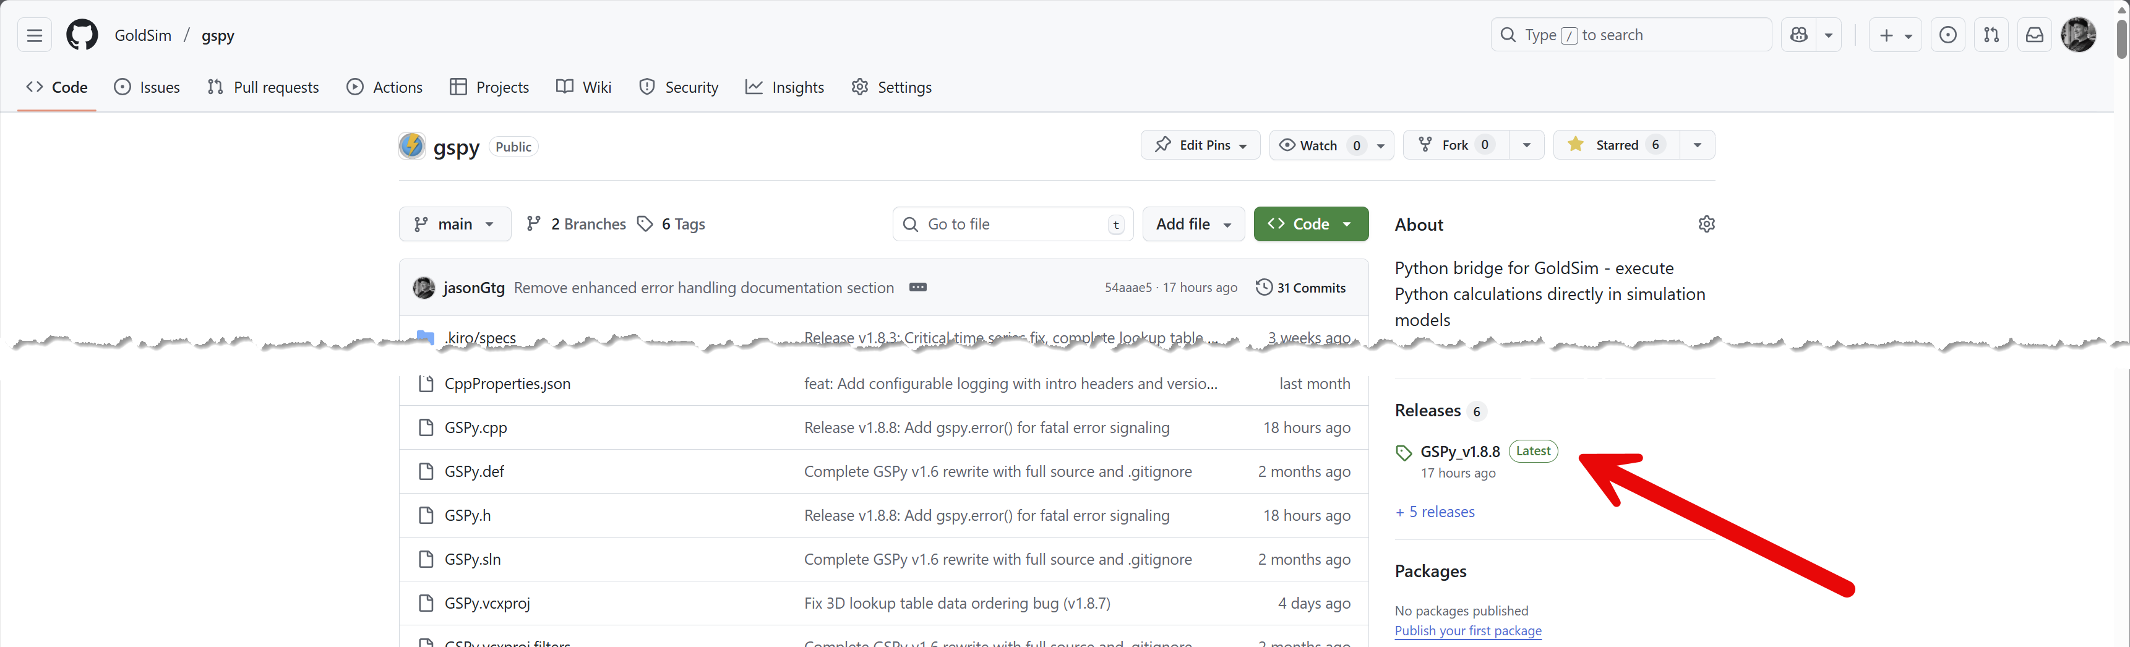
Download and Setup
Go to the Releases page on Github
  Github.com/GoldSim/gspy/releases
  Download the latest zip containing examples and dlls.

Slide 4
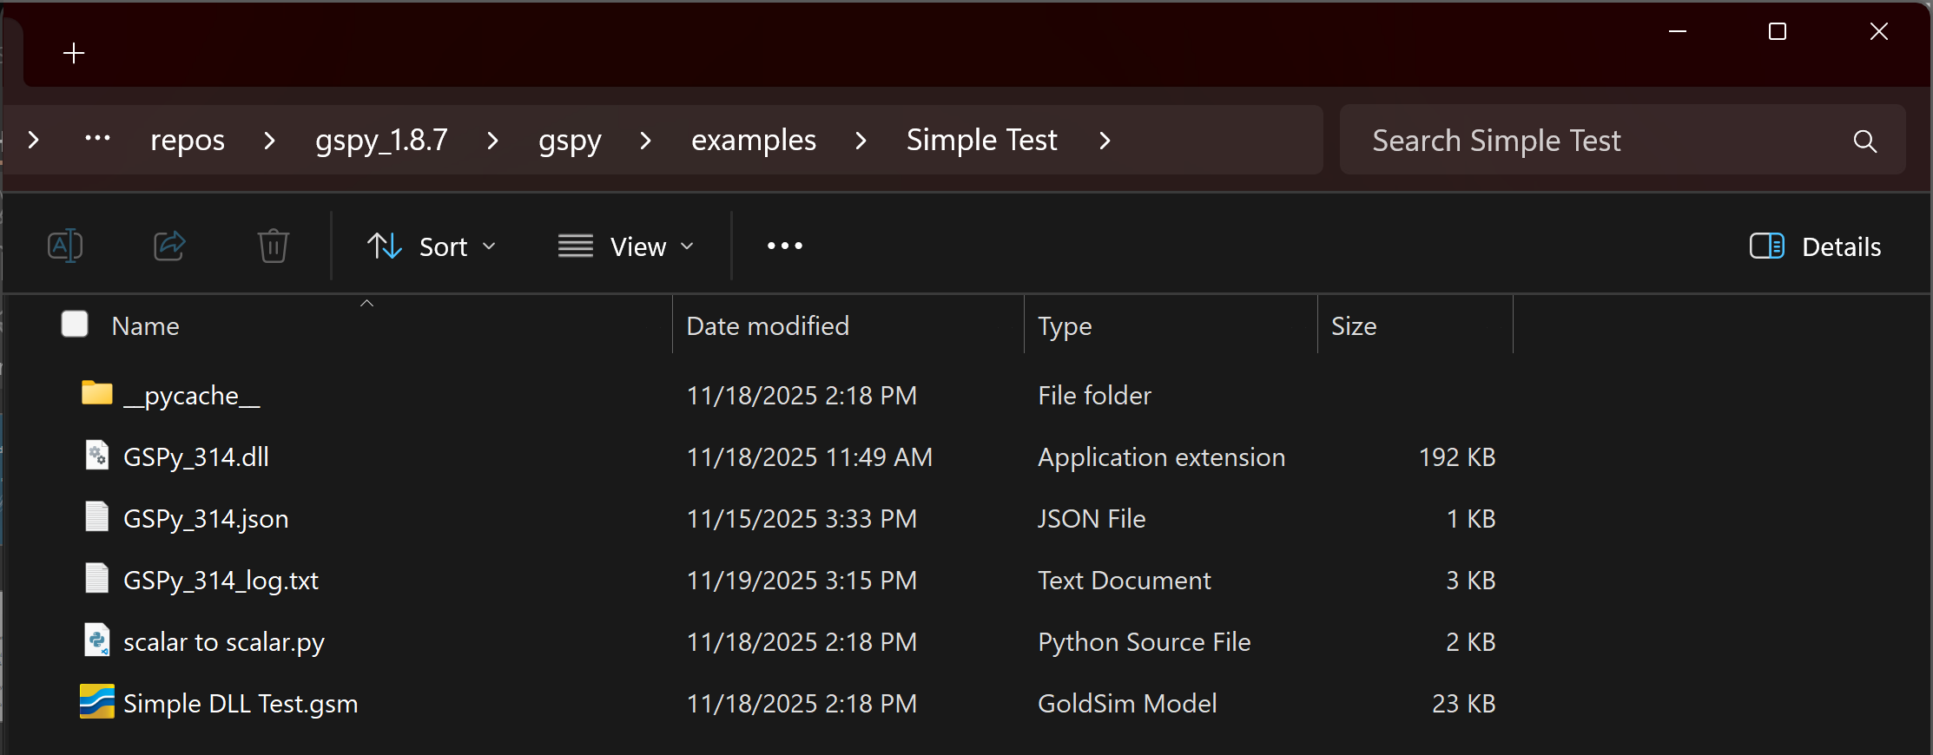
The "Big Picture" Architecture
GoldSim model
GoldSim Model (.gsm) -> Talks to DLL
GSPy DLL (.dll) -> The “bridge“
JSON Config (.json) -> The pre-runtime instructions
Python Script (.py) -> The runtime calculation
GSPy DLL
JSON
Python Script

Slide 5
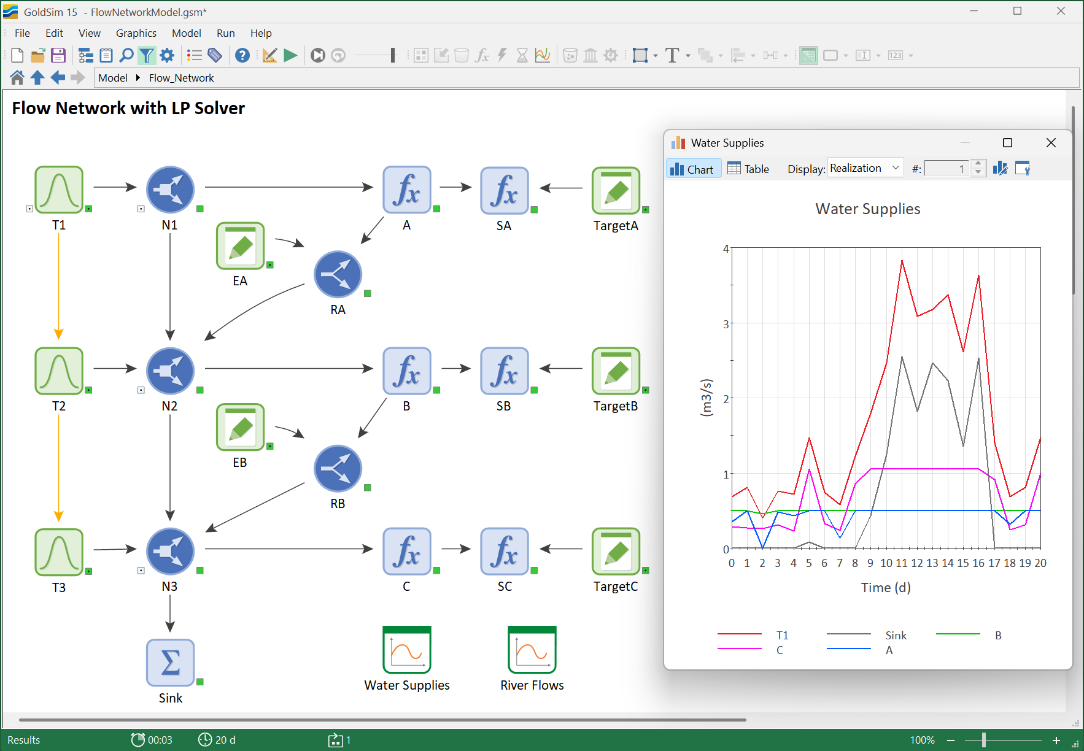
Flow Solver Demonstration
River system with 3 users (A, B, C) and Return Flows.
  Priorities (B > A > C) + Return Flow.
  Need to solve simultaneous priority/feedback logic.
Send system state (Inflows, Demands) to Python.
  Linear Programming.
  Minimize weighted shortage costs.
  Constraints: Enforce mass balance (Water In = Water Out).
Python calculates diversions; GoldSim handles the water balance.

Slide 6
How the Files are Linked
Rule 1: DLL & JSON names MUST match.
  my_calc.dll
  my_calc.json
Rule 2: JSON points to the script.
Inside JSON: "script_path": "my_script.py"
Note: Array sizes must be static in the JSON. GoldSim allocates this memory before it sends any data to Python.
{
"python_path": "C:\\Users\\[user]\\AppData\\Local\\Programs\\Python\\Python314",
"script_path": "mixed_types.py",
"function_name": "process_data",
"log_level": 3,
"inputs": [
{ …etc…

Slide 7
Python Path Setup
GSPy needs TWO path settings:
Windows System PATH
  When: As GoldSim loads the GSPy DLL (at the very start).
  Who: For the Windows OS.
  Why: To find the main python311.dll (or python314.dll).
  (This is a dependency of the GSPy DLL itself).
JSON python_path
  When: After the DLL loads (during methodID = 0, initialization).
  Who: For the GSPy DLL.
  Why: To find your specific Python interpreter.

Slide 8
Troubleshooting: The "Log File" Test
NO Log File Created?
  Diagnosis: System PATH Issue.
  Why: GSPy never started. Windows blocked it.
  Fix: Add Python to Windows System PATH & restart.
Log File EXISTS (but shows errors)?
  Diagnosis: JSON Configuration Issue.
  Why: GSPy started, but got bad instructions.
  Fix: Read the log file! It will tell you if the python_path or script_path is wrong.

Slide 9
Marshalling Internals: "View" vs. "Copy"
Inputs: A "Zero-Copy" View (Fast!)
  GSPy gives Python a direct "window" or "view" into GoldSim's memory.
  No data is copied. Python just looks at the original data.
  This is extremely fast and efficient.
(Technical note: Uses PyArray_SimpleNewFromData)
Outputs: A "Data Copy" (Safe!)
  Step 1: GoldSim "owns" and pre-allocates an "empty box" (the buffer).
  Step 2: Your Python script creates its result (e.g., a NumPy array).
  Step 3: GSPy copies the Python data into GoldSim's empty box.
(Technical note: Uses memcpy)

Slide 10
Why max_points is critical
It's for Outputs Only.
The max_points value in your JSON tells GoldSim how big to make that "empty box" before the simulation starts.
The memcpy (memory copy) function is "dumb“. It doesn't check the size. It just starts copying.
If your Python array is bigger than the box, it will overflow and corrupt GoldSim's memory, leading to a crash or bad data.
max_points is your safety guarantee that the destination buffer is big enough for the data you plan to return.

Slide 11
Logging
gspy.log(“message”, log_level)
Creates a log file (e.g., myscript_log.txt).
Combines two sources:
GSPy's internal C++ operations (init, marshalling)
Your Python script's messages
Avoid print() - Messages go to stdout (console) and are typically lost.
Set log_level=0 in JSON to disable non-error logs. This makes calls nearly free and speeds up simulations.
(Note: The GSPy log is separate from GoldSim's main log file)

Slide 12
Error Handling: Best Practice
Always wrap your Python code in a try...except block.
Why? To catch Python errors gracefully.
Use traceback.format_exc() to get the full error message.
Send the full error to the log using gspy.log().
def process_data(*args):
try:
# Your code here
result = 1 / 0 # This will fail
return (result,)
except Exception:
err_msg = traceback.format_exc()
gspy.log(err_msg, 0) # Log as ERROR
return (0.0,) # Return a safe value
Note: The 'safe' return value must match the structure defined in your JSON (e.g., if output is a vector, return a vector of zeros).

Slide 13
Demonstrations

