Slide 1
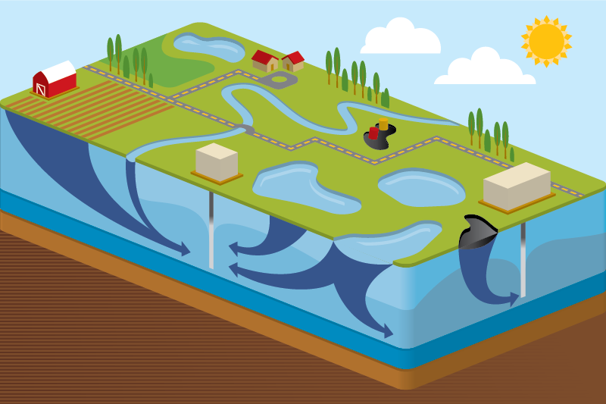
Modeling Water Treatment Using the Contaminant Transport Module
Rick Kossik
rkossik@goldsim.com

Slide 2
GoldSim and the Contaminant Transport Module
  In order to simulate some kinds of complex systems, GoldSim has several specialized extension modules to facilitate simulation of some types of systems
  The Contaminant Transport (CT) Module is a set of specialized tools that are added to GoldSim to support complex contaminant transport simulations
  The CT Module is used to simulate the movement of mass (typically contaminants) through natural (and engineered) systems
    Produces predictions of mass transport rates at defined locations, concentrations in specified environmental media (e.g., water, soil), and impacts to defined human receptors (e.g., dose, health risk)
    Processes that can be simulated include mixing, solubility constraints, sorption, advection, dispersion, diffusion, and chemical reactions and radioactive decay and ingrowth
  In this webinar, a basic understanding of the CT Module is assumed (but we will provide a very quick review)

Slide 3
Webinar Overview
  First, we will provide a very quick and basic overview (10 minutes) of the CT Module
  This webinar will then focus on two relatively simple features in the CT Module that can be used to model water treatment processes:
    Specifying treatment efficiencies
    Specifying solubilities and removing precipitated mass
  We will also mention (but not discuss in any detail) a much more complex way to model treatment:
    Integrating chemical processes directly using theoretical equilibrium and empirical relationships developed by methods outside of GoldSim (e.g., PHREEQC).

Slide 4
Overview of the
Contaminant Transport Module

Slide 5
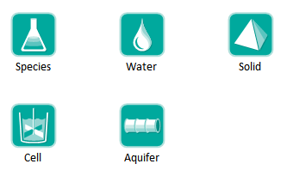
Contaminant Transport Module
Adds specialized elements to facilitate simulation of contaminant transport through engineered and natural environmental systems

Slide 6
Contaminant Transport Module
Provides a basic framework for modeling fate and transport of dissolved, sorbed and/or suspended contaminants through engineered and natural systems
Complexity of the model is determined by the user
While incorporating some basic physics (e.g., conservation of mass, decay and ingrowth, diffusion, partitioning), very few assumptions built into code in order to maximize flexibility
Heavily utilizes arrays

Slide 7
Steps for Modeling Contaminant Transport
Specify species to be modeled
Specify the transport and storage media within the system to be modeled (e.g., water, air, sediment, soil)
Specify the transport pathways through which mass is transported and stored
Define the source terms (initial and/or boundary conditions)
Define the impacts of the species (e.g., dose) on defined receptors

Slide 8
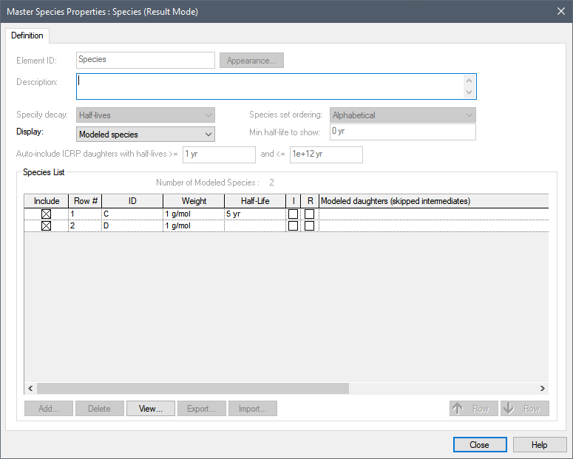

Defining Species
Species element

Slide 9

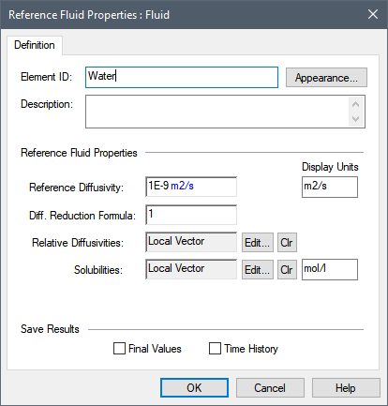

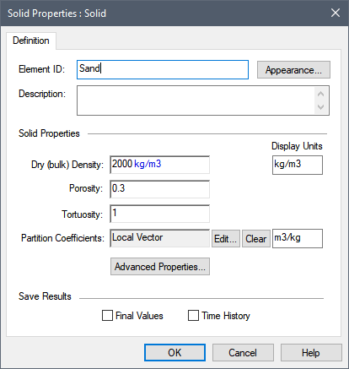
Environmental Media
Basic “building blocks” of transport pathways
  mass transport calculations are based largely on media properties
  Two types: Fluids and Solids

Slide 10
Transport Pathways
Transport pathways represent those parts of the system through which species mass is transported and/or in which species mass is stored.
  Tanks, ponds, aquifers, lakes, soil columns, etc.
You define the properties of the pathways, such as geometry, volume, and pathway discretization.
You define which media (e.g., air, water, sediments, rock) types are present in the pathway

Slide 11
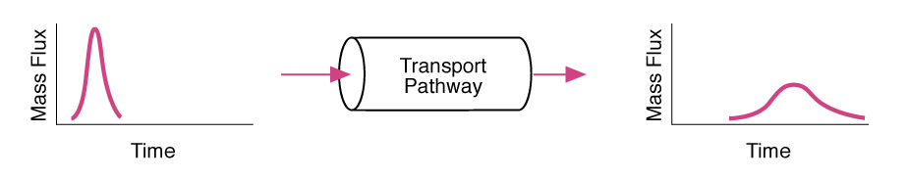
Transport Pathways
Pathways can be thought of as transfer functions
Each pathway type (or transfer function) assumes or represents a particular range of physical transport processes.

Slide 12
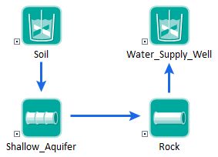
Transport Pathways
You create a mass transport system by defining a network of transport pathways using mass flux links among the pathways.

Slide 13

Transport Pathways
GoldSim provides five type of pathways:
We will focus on Cells today to illustrate features to simulate water treatment

Slide 14
Simulating Water Treatment

Slide 15
Cell Pathways
Act as mixing cells
Specify multiple media
  always contains a single reference fluid
Mass is instantly mixed and equilibrated (partitioned between media) within cell
Solubility constraints can be imposed in cell
Can have specified initial/boundary condition
Behavior of cell network is mathematically equivalent to network of finite volumes

Slide 16
Example: Two Inflows into a Well-Mixed Flow-Through Tank
In this model, we are only mixing two incoming streams of water (no treatment)
  Tank holds 10 m3 of water
  Initially concentration in the tank is 0 g/m3
  Inflow1: 0.5 m3/day of water with concentration of Fe and Zn of 1 g/m3
  Inflow2: 0.5 m3/day of water with concentration of Fe and Zn of 2 g/m3
  1 m3/day of water is discharged (volume stays constant)
System 1
0.5 m3/day
Mixing Tank
1 m3/day
Sink
System2
0.5 m3/day

Slide 17

Equation Solved by GoldSim
$\frac{dm_{tank}}{dt}=Q_{1}C_{1}$ + $Q_{2}C_{2}$ - $Q_{tank}\frac{m_{tank}}{V_{tank}}$

Slide 18
Modeling Treatment
We would like to treat the water entering the mixing tank
GoldSim provides two simple ways to model treatment:
  Approach #1: Define a treatment efficiency, that represents the fraction of incoming mass that is removed from system.
  Approach #2: Define solubilities for species in the treatment tank, and remove all precipitated mass from the system.
There is also a much more complex (and potentially much more realistic) way to model treatment:
  Approach #3: Integrate chemical processes directly using theoretical equilibrium and empirical relationships developed by methods outside of GoldSim (e.g., PHREEQC).
We will point to some examples of Approach #3 in our Model Library, but will not discuss in any detail today. Instead we will focus on Approaches #1 and #2. These are simple approaches that can be appropriate in many instances.

Slide 19
Approach #1: Defining Treatment Efficiencies
Define a treatment efficiency, that represents the fraction of incoming mass that is removed from system
Mass Sink
Upstream System 1
X g/day
Treatment Tank
(X + Y) * Treatment Efficiency
Upstream System 2
Y g/day
Downstream System
Mass Removal Rate = Mass Inflow Rate * Fraction

Slide 20
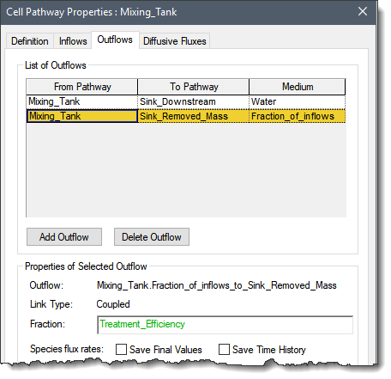
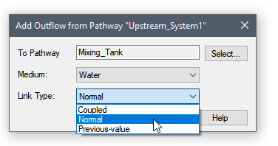
Approach #1: Defining Treatment Efficiencies
Define two different outflows from the tank:
  Existing outflow that represents treated water leaving tank
  New outflow that represents the treatment process
      Defined by specifying “Fraction_of_Inflows” instead of an actual Medium
Must define all incoming flows as “Normal” links rather than “Coupled” links
Mass Removal Rate = Mass Inflow Rate * Fraction

Slide 21
Approach #2: Defining Solubilities and Remove Precipitated Mass
Define solubilities for species in the treatment tank, and remove all precipitated mass from the system.
Solubilities defined locally in treatment tank
Mass Sink
Upstream System 1
X g/day
Treatment Tank
Precipitated mass flushed out
Upstream System 2
Y g/day
Downstream System
Q*Solubility

Slide 22
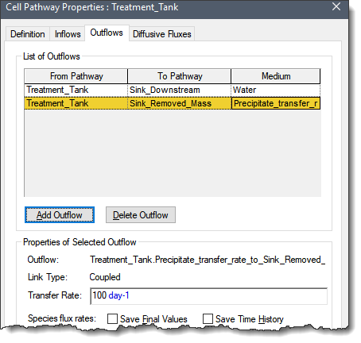
Approach #2: Defining Solubilities and Remove Precipitated Mass
Define solubilities in the tank locally (by cloning the Fluid element)
Define two different outflows from the tank:
  Existing outflow that represents treated water leaving tank
  New outflow that represents the treatment process
      Defined by specifying “Precipitate_transfer_rate” instead of an actual Medium
Any precipitated mass is removed based on a specified fractional rate. Specifying a high fractional rate effectively removes it immediately

Slide 23
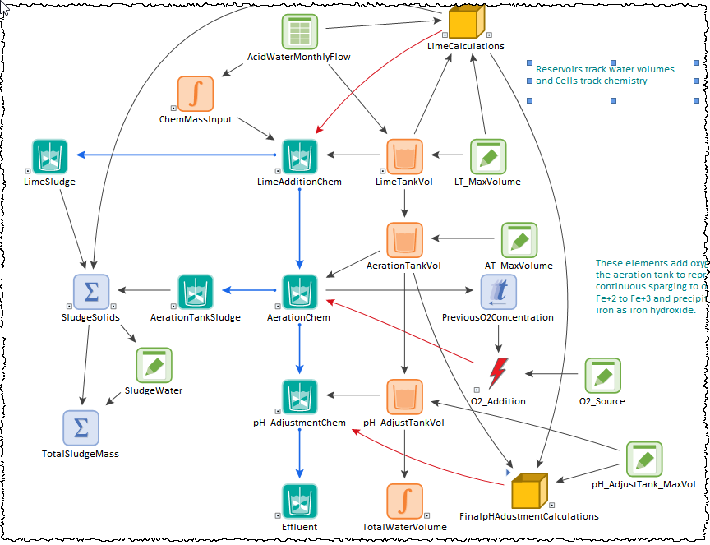
Approach #3: Simulating Treatment Processes Using Geochemical Equilibrium Models
Integrate chemical processes directly using theoretical equilibrium and empirical relationships developed by methods outside of GoldSim (e.g., PHREEQC).
This example simulates some of the major chemical processes that occur in a water treatment plant designed to neutralize and remove metals from an influent water typical of acid mine drainage. These processes require lime and air addition to the water and produce sludge.
Requires geochemical expertise and careful coupling of GoldSim to external code

Slide 24
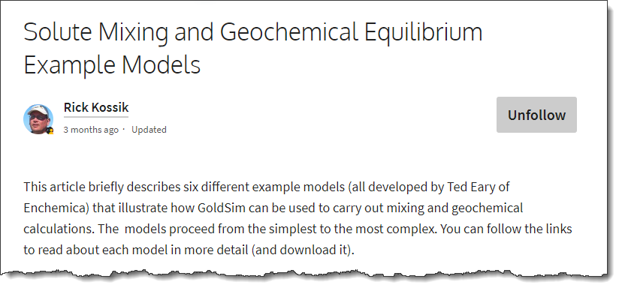
Approach #3: Simulating Treatment Processes Using Geochemical Equilibrium Models
https://support.goldsim.com/hc/en-us/articles/360011433454-Solute-Mixing-and-Geochemical-Equilibrium-Example-Models

Slide 25
Summary
The Contaminant Transport Module provides a number of features to model treatment processes within an environmental system
Two very simple (but powerful) approaches:
  Approach #1: Define a treatment efficiency, that represents the fraction of incoming mass that is removed from system.
  Approach #2: Define solubilities for species in the treatment tank, and remove all precipitated mass from the system.
If these simple approaches are not sufficient, you can integrate chemical processes directly using theoretical equilibrium and empirical relationships developed by methods outside of GoldSim (e.g., PHREEQC).
  This, of course, is much more complex and requires significantly more effort
  Examples are provided in the GoldSim Model Library

