Slide 1
GoldSim 14 Overview
Rick Kossik
GoldSim Technology Group

Slide 2




Recent GoldSim Releases
12.1.1
12.1.2
12.1.3
12.1.4
12.1.5
Newton
1643-1727
12
Pascal
1623-1662
14
2017
2018
2019
2020
2021
2022
Oppenheimer
1904-1967
12.1
Notes:
Eiger:
Enhanced Source element
Import/export of Species element data
Cell-net Generator
Fuji:
-New Time History result features, such as ability to display a user-selected statistic
-Time History Result export and new formats
-Performance improvements
-improvements on Stock elements
-ability to temporarily disable generation of time history results
Glacier:
5 new elements:
Allocator: allocates an incoming signal based on specified set of demands and priorities
Splitter: splits an incoming signal based on specified set of fractions
History Generator: generates stochastic time series given some statistical inputs (e.g., growth rate, volatility)
SubModel: uses an entire GoldSim model as a function in another GoldSim model; submodel can be a static, deterministic model, dynamic, MC model or an optimization
Interrupt: used for debugging and user warnings; triggered by a condition or event; when triggered, the model can be pauses to display a message, log a message or stop the realization or simulation.
New Financial Module:
includes 5 elements
simulates accounts with interest, deposits and withdrawals
computes the NPV and IRR of a series of cash flows
investments with purchases and sales
simulates different types of financial options
simulates claims against an insurance policy
New Array functions to dynamically extract vectors from matrices or scalar items from vectors or matrices; GetRow(), GetCol(), GetItem()
Hood:
-New Time Series element with recording and playback functions
-Ability to save results in Submodels
-Ability to ‘push’ table and time series definitions into Submodels
-Updated External and External Pathway elements

Slide 3
What is in GoldSim 14?
Things that you won’t notice directly (but perhaps made up the majority of the effort involved!)
  Large number of performance and reliability improvements, minor user-interface enhancements and bug fixes
A number of new features and elements
  How are these selected?
    User Requests
    Experience with user models
    GTG long-term “vision” for GoldSim

Slide 4
Final Value Results
Final Value results are used to carry out side-by-side comparisons of the final values (and Capture Times) of outputs for different types of simulations.
You need to carefully specify what you wish to compare and how you want to display that comparison.
Depending on how your model has been run (e.g., multiple realizations, multiple scenarios, multiple Capture Times) and the outputs you have specified to compare (e.g., one output, multiple outputs, vector results, matrix results), there can be a large variety of ways to display the comparison.

Slide 5
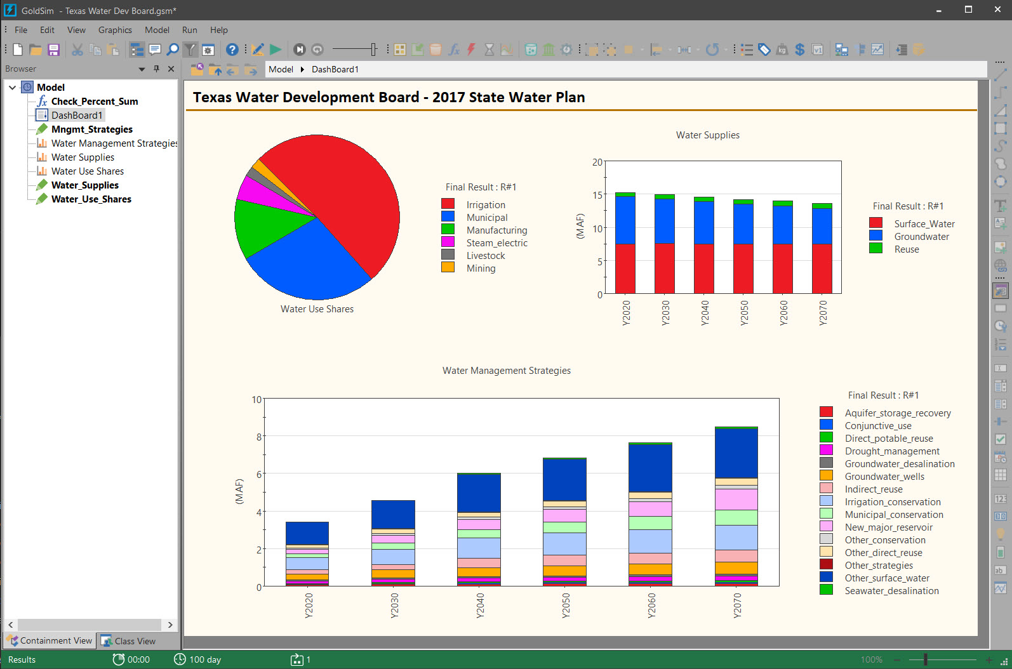
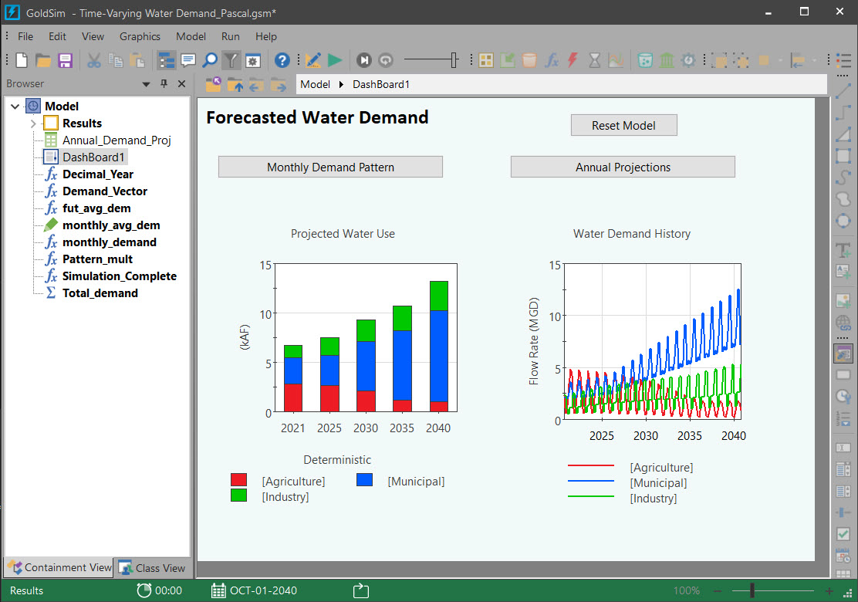
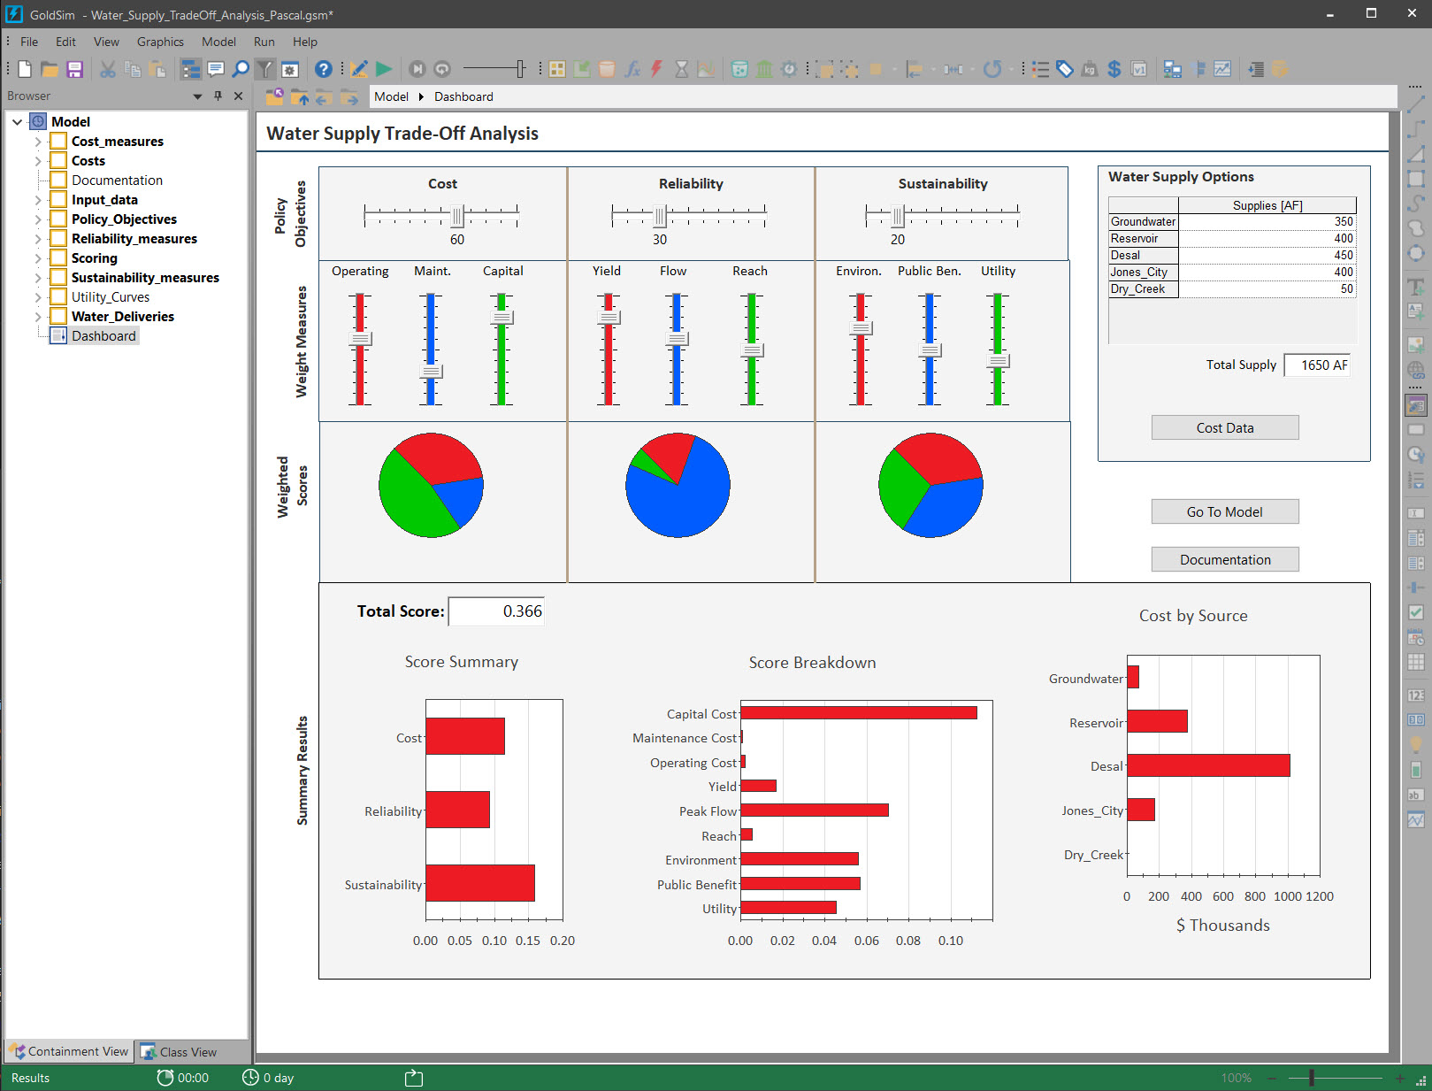
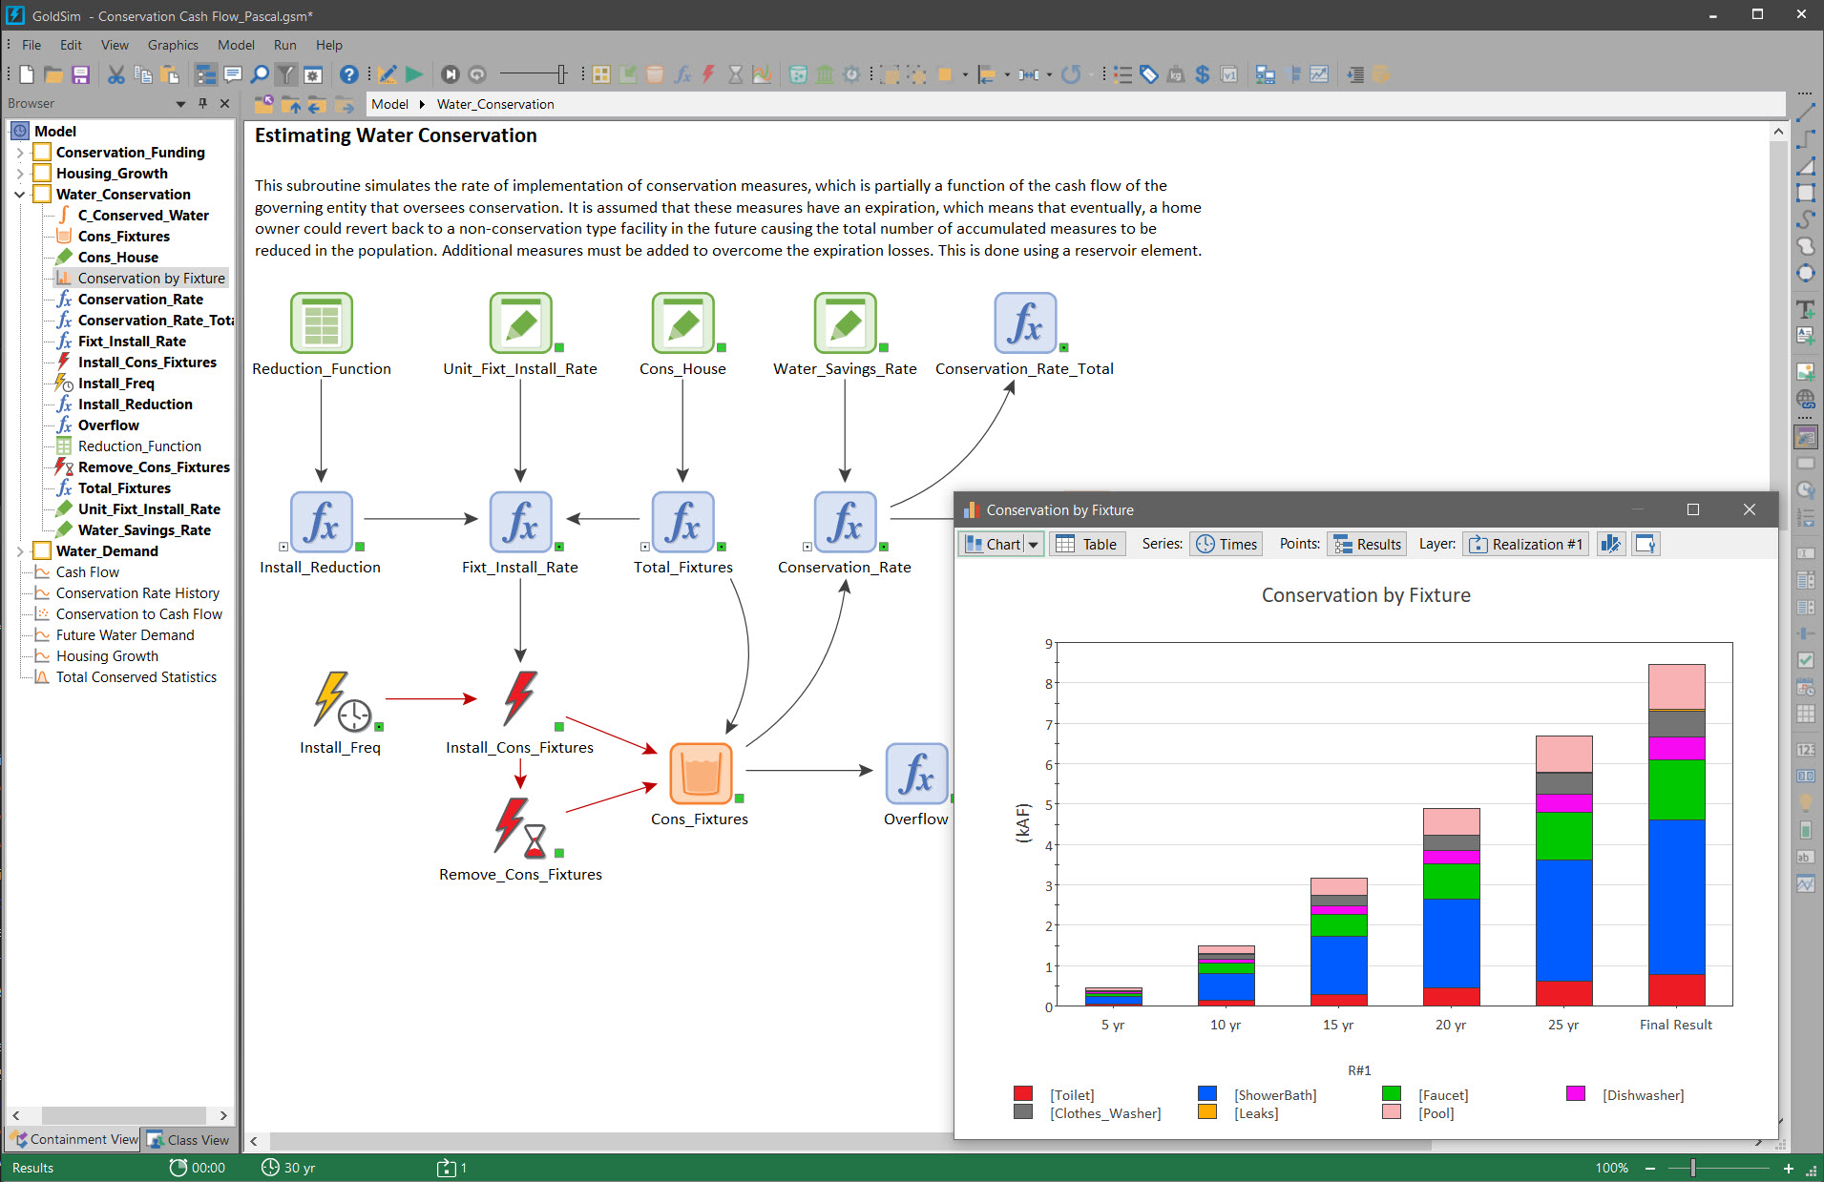
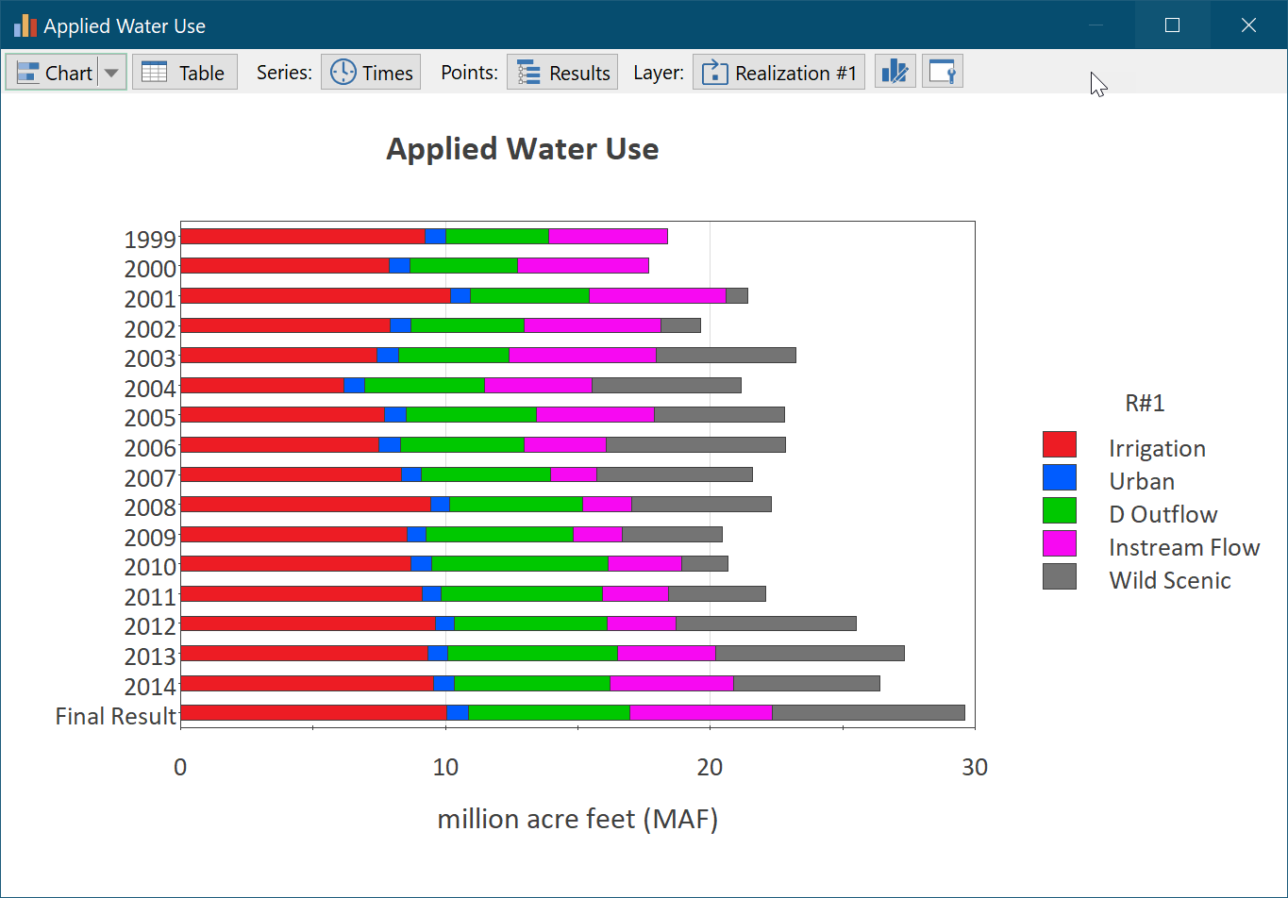
Final Value Results

Slide 6
Final Value Results: “One-Dimensional Data”
One of the simplest Final Value results you might want to display is the comparison of multiple outputs for a deterministic run or a single realization.
There are three ways to display this:
  Column chart
  Bar chart
  Pie chart
There are two possible ways to view this same data in tabular form, either as rows or columns of values.
We can think of this as a “one-dimensional” set of results: the one dimension being the different outputs

Slide 7
Final Value Results: “Two-Dimensional Data”
We can make this “one-dimensional” data set “two-dimensional” by running a Monte Carlo simulation. In this case, the final values we would want to look at would likely be statistics (e.g., the mean or some percentile) for each of the multiple outputs.
Again, there are two possible ways to view this same data in tabular form, either as rows or columns of values.
There are a much wider variety of ways to display this information as a chart (in fact, 14!):
  Clustered Column chart (two types)
  Clustered Bar chart (two types)
  Pie chart (two types)
  Stacked Column and Stacked Bar charts (two types)
  100% Stacked Column and Stacked Bar charts (two types)

Slide 8
Final Value Results: “Three-Dimensional Data”
We can make this “two-dimensional” data set “three-dimensional” by running multiple scenarios. In this case, the final values we would want to look at would be statistics (e.g., the mean or some percentile) for each of the multiple outputs for each scenario.
Now there are multiple ways to view this same data in tabular form, either as rows or columns of values.
There are even more ways to display this information as a chart (in fact, well over 40!)
  Because charts can only be “two-dimensional”, we need to select a “layer” to display (e.g., all results and all statistic for a particular scenario)

Slide 9
Final Value Results: “Three-Dimensional Data”
Another way we can create a “three-dimensional” data set is by creating and viewing multiple Capture Times. In this case, the final values we would want to look at would be statistics (e.g., the mean or some percentile) for each of the multiple outputs for each Capture Time.

Slide 10
Final Value Results: Arrays
Final Value results can display Arrays (vectors and matrices) in multiple ways.
Such results can actually have 4 dimensions (e.g., all Rows and Columns for a particular Statistic and Capture Time).

Slide 11
Final Value Results: Handling Negative Values
Final Value column and bar charts display negative values on the opposite side of the 0 axis

Slide 12
Final Value Results: Dashboards
Final Value charts and tables can be embedded in Dashboards (like other Result elements)

Slide 13
Final Value Results: Summary
The Final Value result is very powerful and flexible, and allows you to produce a variety of charts and tables to display results at the end of the simulation (Final Values) or at defined Capture Times.
At their most complex level, charts can display up to two “dimensions” of results from higher dimensional data sets (e.g., multiple outputs and multiple statistics for a selected scenario; multiple outputs and multiple scenarios for a selected statistic, multiple statistics and multiple scenarios for selected output).
Tables can display the full data set selected (by increasing the number of columns).
The various charts and tables can be displayed and rearranged in a wide variety of ways, giving you great flexibility in order to emphasize specific aspects of the results.

Slide 14
Logic Tree Element
A new element for creating complex logic
Logic Tree elements have a single output, which is a scalar condition (True or False). The logical framework of Logic Trees is constructed using a number of gate nodes (AND-gates, OR-gates, N-Vote gates). The various gate nodes have child nodes (sub-nodes) and the gates are evaluated based on the value (True or False) of their child nodes and the type of gate.
Gates can be nested with no limit (hence, creating a “tree”), which allows very complex logic to be represented.

Slide 15
Logic Tree Element: Example
IF the Water Level is Rising
AND
Water Level > 10 m
OR
2 out of 3 pumps have Failed
Then
Set to Emergency to True
Else
Set Emergency to False

Slide 16
New Color Palette and Managing Custom Colors
A new updated (modern) color palette was incorporated into GoldSim 14
Many users have asked for way to manage, save and reuse a consistent set of custom colors
GoldSim 14 allows you to
  Create a set of custom colors
  Access these colors in any location in the model
  Import and export custom colors for use in other models

Slide 17
Date Functions
To assist in using dates in your models, GoldSim 14 provides a number of new specialized functions that can be used to create dates and provide information on variables that represent dates:
Function | Description
GetYear(Date) | Returns the calendar year (dimensionless value)
GetMonth(Date) | Returns the calendar month (dimensionless value from 1 to 12)
GetDay(Date) | Returns the day of the month (dimensionless value from 1 to 31)
GetDayofYear(Date) | Returns the day of the year (dimensionless value from 1 to 366)
GetHour(Date) | Returns the hour of the day (dimensionless value from 1 to 24)
GetMinute(Date) | Returns the minute of the hour (dimensionless value from 1 to 60)
GetSecond(Date) | Returns the second of the minute (dimensionless value from 1 to 60)
MakeDate(Year, Month, Day) | Returns a date built from those integer inputs
MakeDateTime(Year, Month, Day, Hour, Minute, Second) | Returns a date/time built from those integer inputs
IsLeapYear(Date) or IsLeapYear(Year) | Returns a condition (True or False)

Slide 18
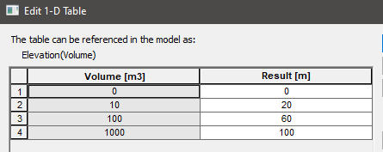
Lookup Table Functions
Sometimes you may want to return the minimum or maximum value of the dependent variable defined in your Lookup Table.
GoldSim provides two special functions to support this. To illustrate their use, consider the following 1-D Lookup table (named Elevation):
Tablemin(Elevation) would return 0 m
Tablemax(Elevation) would return 100 m

Slide 19
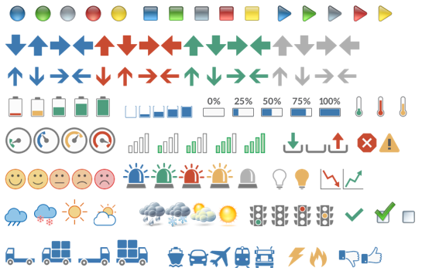
New Dashboard Features
Simulation Time Control
  You can specify the Start Date and End Date (Calendar time models) or Duration (Elapsed time models) from the Dashboard
Enhanced Scenario Control
  You can control what is displayed in the Dashboard
Reset Model Button
New Icons for Result Status Control
  Some new icons have been added (that were not available before).
  Many (but not all) icons were replaced with similar icons (with a slightly different style).
  One set of icons (flags) were eliminated. If these are being used in a model, they will be replaced with triangles (of similar colors).

Slide 20
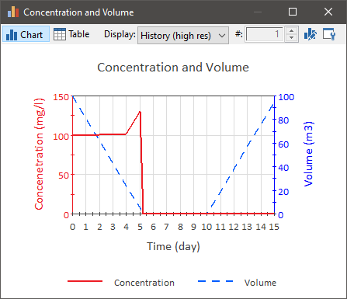
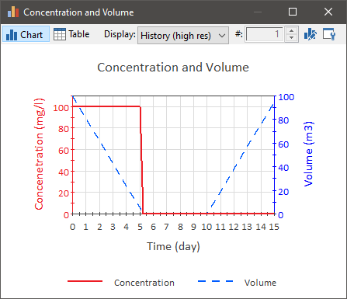
CT Improvements to Support Emptying Cells
A problem that can be encountered in some contaminant transport models is that Cells (e.g., representing ponds) can sometimes empty and refill
GoldSim was not originally designed to handle this situation well (resulting in concentration “spikes” when the Cell emptied or started to fill)
The solution to the problem cannot be completely be automated
In GoldSim 14:
  More warnings are provided to alert you to any potential issues
  The CT algorithm was modified to partially address this
  Detailed instructions are provided to modify the model to fully address it

Slide 21
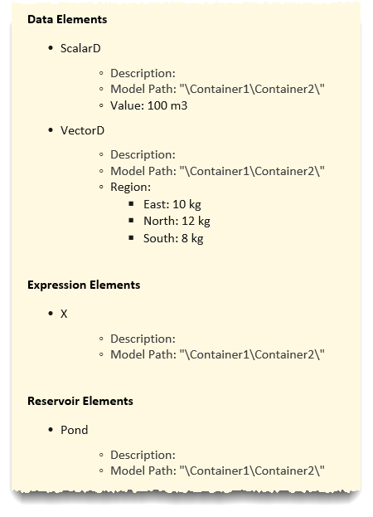
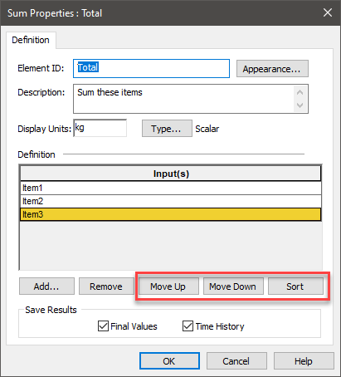
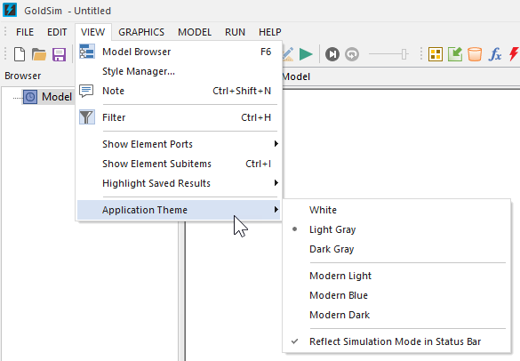
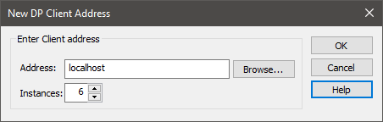
Lots of Other Minor Changes…
Moving and sorting items in a Sum element
Improvements to the Distributed Processing Module
  For example, much easier to add local client machines
Cosmetic change: new Application Themes that you can choose
XML file output now includes full definition of all Data elements in model
Setting the Start Time, End Time and Duration from the Command Line

Slide 22
Converting Older Files
12 and 12.1 files should open in 14 seamlessly
Only conversion issues are minor and cosmetic
  Changes in color palette
  Changes in Result Status Control images
Older files (e.g., 11) should open but may have more cosmetic issues due to the significant user interface changes in 12

Slide 23
What’s Cooking?
Contaminant Transport Online Course (January 2022)
  Basic GoldSim Online Course has been updated for GoldSim 14
Next version (14.1?)
  Features and new elements to make it easier to ensure a mass balance

