Slide 1
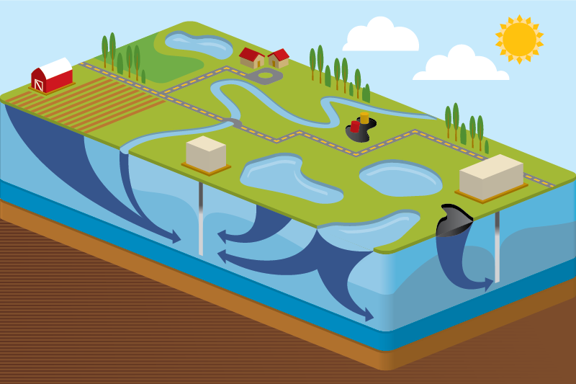
Introduction to the Contaminant Transport Module
Rick Kossik
rkossik@goldsim.com

Slide 2
GoldSim and the Contaminant Transport Module
The basic GoldSim framework consists of a flexible set of tools for creating dynamic, probabilistic simulations of nearly any kind of complex system
These tools are very abstract (like a programming language)
They simply carry out mathematical calculations (e.g., numerical integration) that are applicable to many types of problems
It is assumed you are familiar with the basic GoldSim framework
In order to simulate some kinds of complex systems, such tools are not sufficient. Therefore, GoldSim has several specialized extension modules to facilitate simulation of some types of systems
The Contaminant Transport Module is a set of specialized tools that are added to GoldSim to support complex contaminant transport simulations

Slide 3
GoldSim and the Contaminant Transport Module
The module is used to simulate the movement of mass (typically contaminants) through natural (and engineered) systems
Produces predictions of mass transport rates at defined locations, concentrations in specified environmental media (e.g., water, soil), and impacts to defined human receptors (e.g., dose, health risk)
Processes that can be simulated include mixing, solubility constraints, sorption, advection, dispersion, diffusion, and chemical reactions and radioactive decay and ingrowth
Can this be done with basic GoldSim?
Simple mixing problems could be simulated, but any complex processes would be difficult or impossible to simulate without the Contaminant Transport Module

Slide 4
There are Two Contaminant Transport Module Versions
CT and RT
RT includes several specialized features primarily used to simulate the transport of radionuclides (e.g., simulation of decay chains)

Slide 5
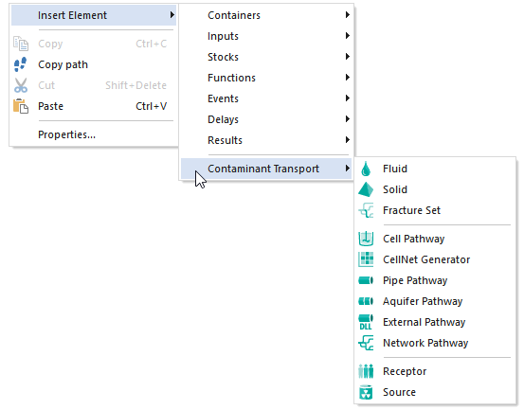
What is the Contaminant Transport Module?
A set of specialized elements that are added to GoldSim to support complex contaminant transport simulations
RT Module Only
r

Slide 6
Some Contaminant Transport Examples…

Slide 7
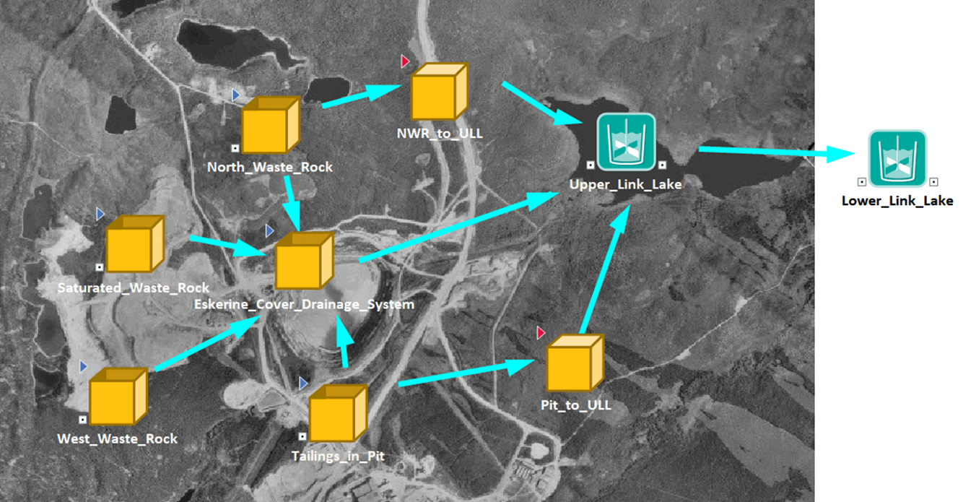
Uranium Mine Closure

Slide 8
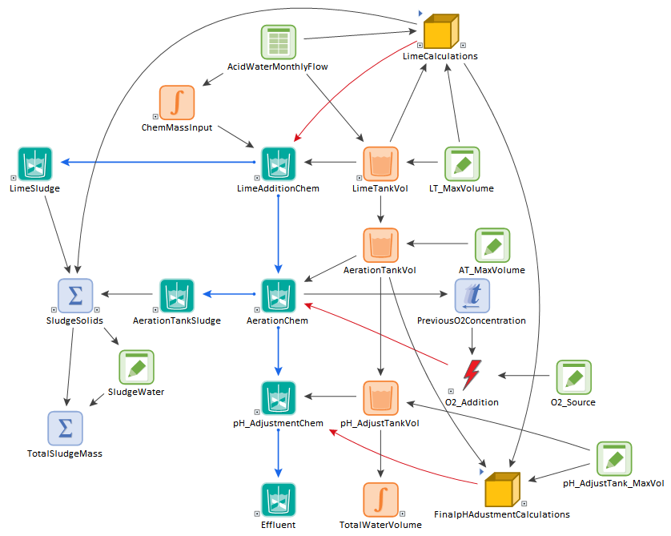
Mine Water Treatment

Slide 9
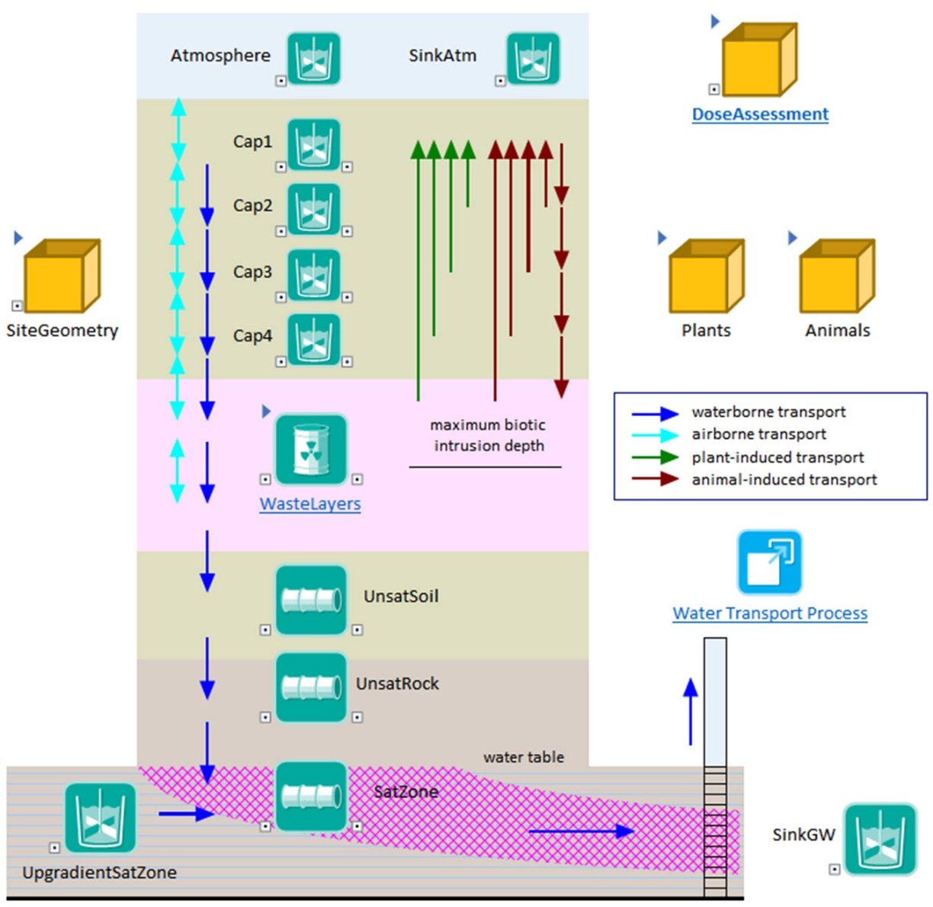
Shallow Disposal Facility

Slide 10
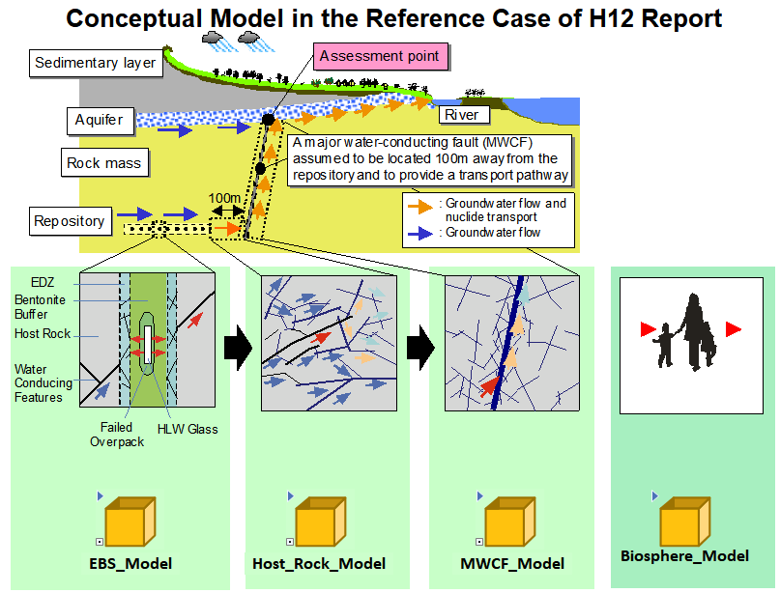
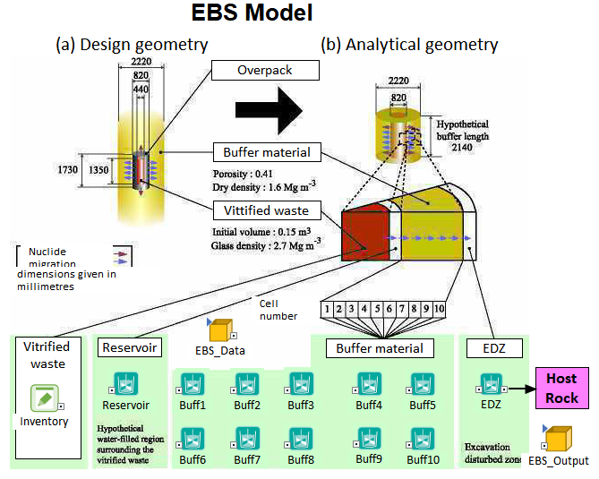
Deep Disposal Facility

Slide 11
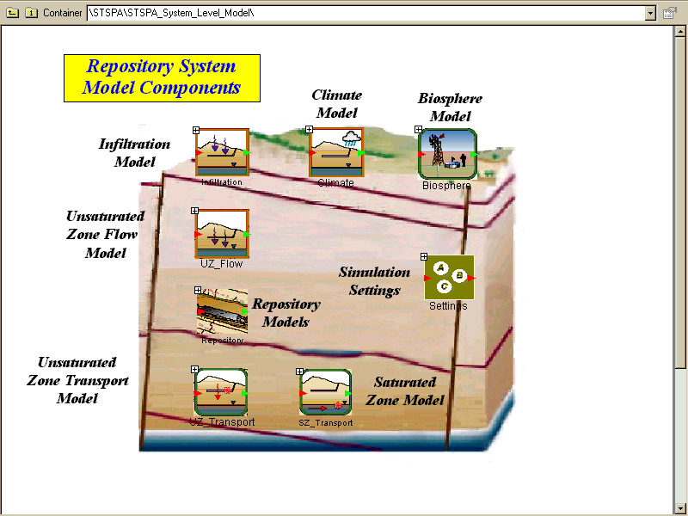
Yucca Mountain

Slide 12
How Detailed and Highly Discretized Should Your Contaminant Transport Model Be?
Just because you can build a large, highly discretized model does not mean you should
How much uncertainty do you have in the source?
How much uncertainty do you have in the key transport properties (e.g., partition coefficients, solubilities)?
Do you really understand the dispersive characteristics of the system?
As a general rule, our ability to predict concentrations is much poorer (i.e., subject to greater uncertainty) than our ability to predict flows

Slide 13
Since all models are wrong the scientist cannot obtain a "correct" one by excessive elaboration… Just as the ability to devise simple but evocative models is the signature of the great scientist, so overelaboration and overparameterization is often the mark of mediocrity. George Box, Science and Statistics (1976)

Slide 14
Top-Down Modeling

Slide 15
Overview of the Contaminant Transport Module

Slide 16
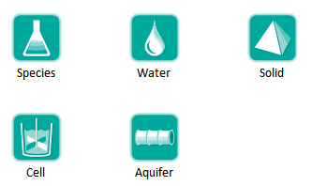
Contaminant Transport Module
Adds specialized elements to facilitate simulation of contaminant transport through engineered and natural environmental systems
We will focus on only these five elements

Slide 17
Contaminant Transport Module
Provides a basic framework for modeling fate and transport of dissolved, sorbed and/or suspended contaminants through engineered and natural systems
Complexity of the model is determined by the user
While incorporating some basic physics (e.g., conservation of mass, decay and ingrowth, diffusion, partitioning), very few assumptions built into code in order to maximize flexibility
Heavily utilizes arrays

Slide 18
Steps for Modeling Contaminant Transport
Specify species to be modeled
Specify the transport and storage media within the system to be modeled (e.g., water, air, sediment, soil)
Specify the transport pathways through which mass is transported and stored
Define the source terms (initial and/or boundary conditions)
Define the impacts of the species (e.g., dose) on defined receptors

Slide 19
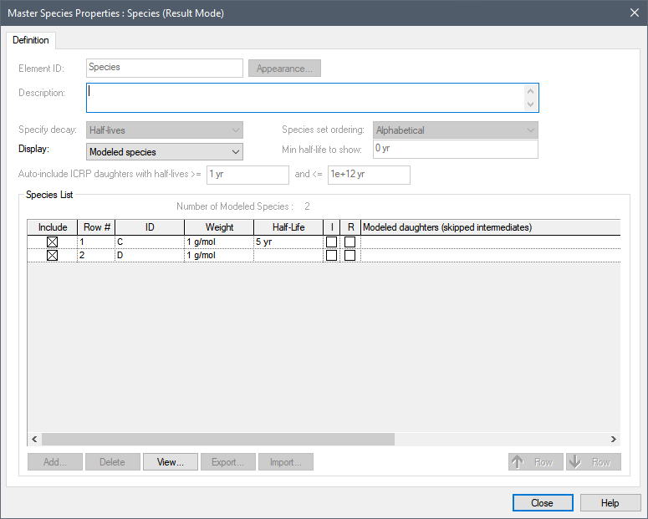
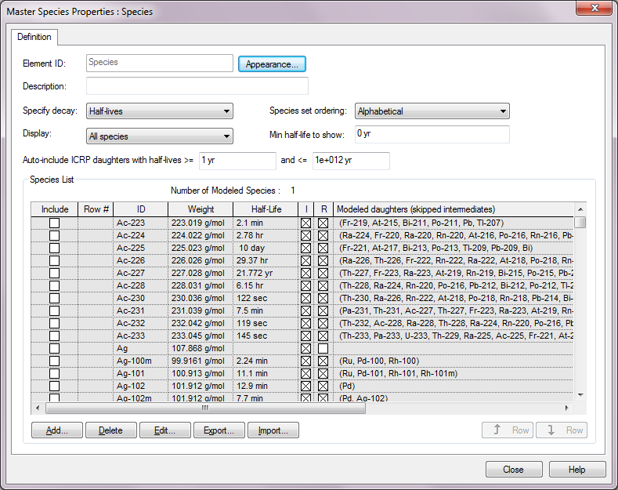
Defining Species
Species element

Slide 20
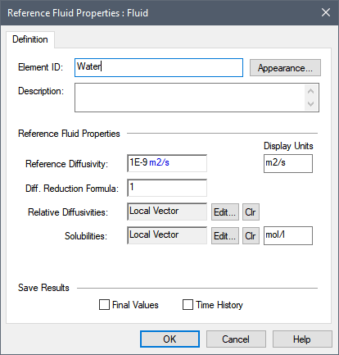
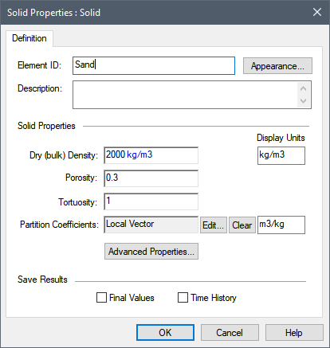
Environmental Media
Basic “building blocks” of transport pathways
mass transport calculations are based largely on media properties
Two types: Fluids and Solids

Slide 21
Transport Pathways
Transport pathways represent those parts of the system through which species mass is transported and/or in which species mass is stored.
Tanks, ponds, aquifers, lakes, soil columns, etc.
You define the properties of the pathways, such as geometry, volume, and pathway discretization.
You define which media (e.g., air, water, sediments, rock) types are present in the pathway

Slide 22
Transport Pathways
Pathways can be thought of as transfer functions
Each pathway type (or transfer function) assumes or represents a particular range of physical transport processes.

Slide 23
Transport Pathways
GoldSim provides five type of pathways:
We will focus on Cells and Aquifers today

Slide 24
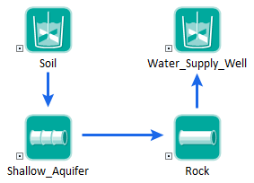
Transport Pathways
You create a mass transport system by defining a network of transport pathways using mass flux links among the pathways.

Slide 25
Pathways Mass Balance
Species mass is conserved.
The Contaminant Transport Module simulates mass transport so it solves for the mass of each species in each transport pathway.
The water, or other media, balance is not solved by the Contaminant Transport Module.
Media advection rates and quantities are inputs for transport pathways.
You can link the transport media advection rates to a water balance model (or other media balance model) in order to enforce both a water balance and species mass balance.

Slide 26
Contaminant Sources
You can specify initial and boundary conditions in Pathways.
In some cases, however, direct specification of an initial condition or rate of input is not possible. The RT Module allows you to simulate a source term using a Source element. The Source element simulates:
Failure of barriers containing the mass
Degradation of matrix material (e.g., grout) in which the mass is bound
Particularly useful when simulating engineered barrier systems
Won’t discuss further

Slide 27
Receptors
The objective of many studies is not only to compute contaminant concentrations and fluxes at various locations, but to also compute the impact of these contaminants on specified receptors.
GoldSim provides a Receptor element that facilitates the conversion of contaminant concentrations in media within pathways to impact to defined receptors (e.g., dose, health risk).
Won’t discuss further

Slide 28
Let’s Look at Some Simple Models

Slide 29
Cell Pathways
Act as mixing cells
Specify multiple media
always contains a single reference fluid
Mass is instantly mixed and equilibrated (partitioned) within cell
Solubility constraints can be imposed in cell
Can have specified initial/boundary condition
Behavior of cell network is mathematically equivalent to network of finite difference nodes

Slide 30
Mass Flux Links
Mass flux links connect pathway elements within a pathway network.
Behavior of a pathway network is primarily controlled by the manner in which mass flux links are defined.
Five types:
Advective
Diffusive
Three special purpose types (will not discuss)
Multiple links can be made between/among pathways.
Mass fluxes are vectors by species with dimensions of mass/time.

Slide 31
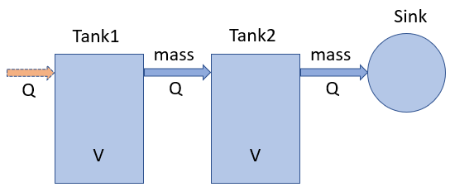
Example1: Simple Advection
Two well-mixed tanks filled with a fixed volume of water (V). Water flows through the tanks at a constant rate (Q) and is ultimately discharged to a sink.
A small quantity of contaminant X is initially introduced into Tank1. Tank2 initially has no mass.

Slide 32
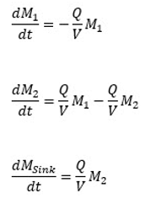
Equations Solved By GoldSim

Slide 33
Example2: Advection with Partitioning
Add second species named Y (also added initially to Tank1)
Each Tank contains some sand
Y partitions onto the sand (X does not)
Assume sand mixes with water flowing through the tank (and there is instantaneous partitioning), but sand does not move with the water out of the tank

Slide 34
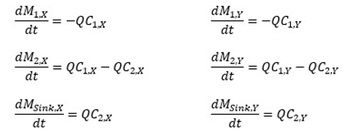
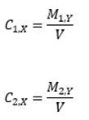
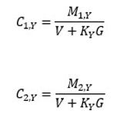
Equations Solved by GoldSim

Slide 35
Example3: Advection With Solubility
Two well-mixed tanks filled with a fixed volume of water (V). Water flows through the tanks at a constant rate (Q) and is ultimately discharged to a sink.
A small quantity of contaminant X and Y are initially introduced into Tank1. Tank2 initially has no mass.
X is infinitely soluble. Y has a solubility limit.
Note: this is a very simple way to represent solubility constraints, and a much more detailed approach accounting for the actual geochemical behavior is often necessary (e.g., linking dynamically or through lookup tables to a geochemical equilibrium code)

Slide 36
How Does this Affect the Equations?

Slide 37
Diffusive Mass Flux Links
Implements molecular diffusion among pathways.
Transport in a stagnant or slowly moving fluid via molecular diffusion
Diffusive flux is bi-directional (unlike advective links, mass can move in either direction). Mass will move from high concentration to low concentration, driven by the concentration gradient between the cells.

Slide 38
Diffusive Mass Rate
Diffusive mass rate = dm/dt
(Diffusive Conductance) x (Concentration Difference)
Diffusive Conductance term is computed as follows:
D = (A d t n r) / L
where:
D is the Diffusive Conductance (L³/T); A is the diffusive area (L²); d is the diffusivity in the fluid (L²/T); n is the porosity of the porous medium; t is the tortuosity of the porous medium; r is the Diffusivity Reduction (the default value is 1); and L is the total diffusive length (L).

Slide 39
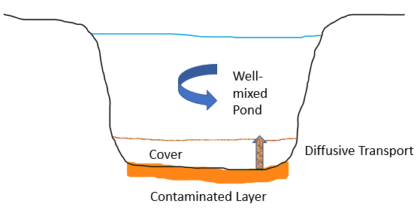
Example4: Diffusion
Cover exists on top of contaminated sediment at bottom of pond
Contaminated sediment is at a constant concentration
Contaminant must diffuse through cover to reach the pond

Slide 40
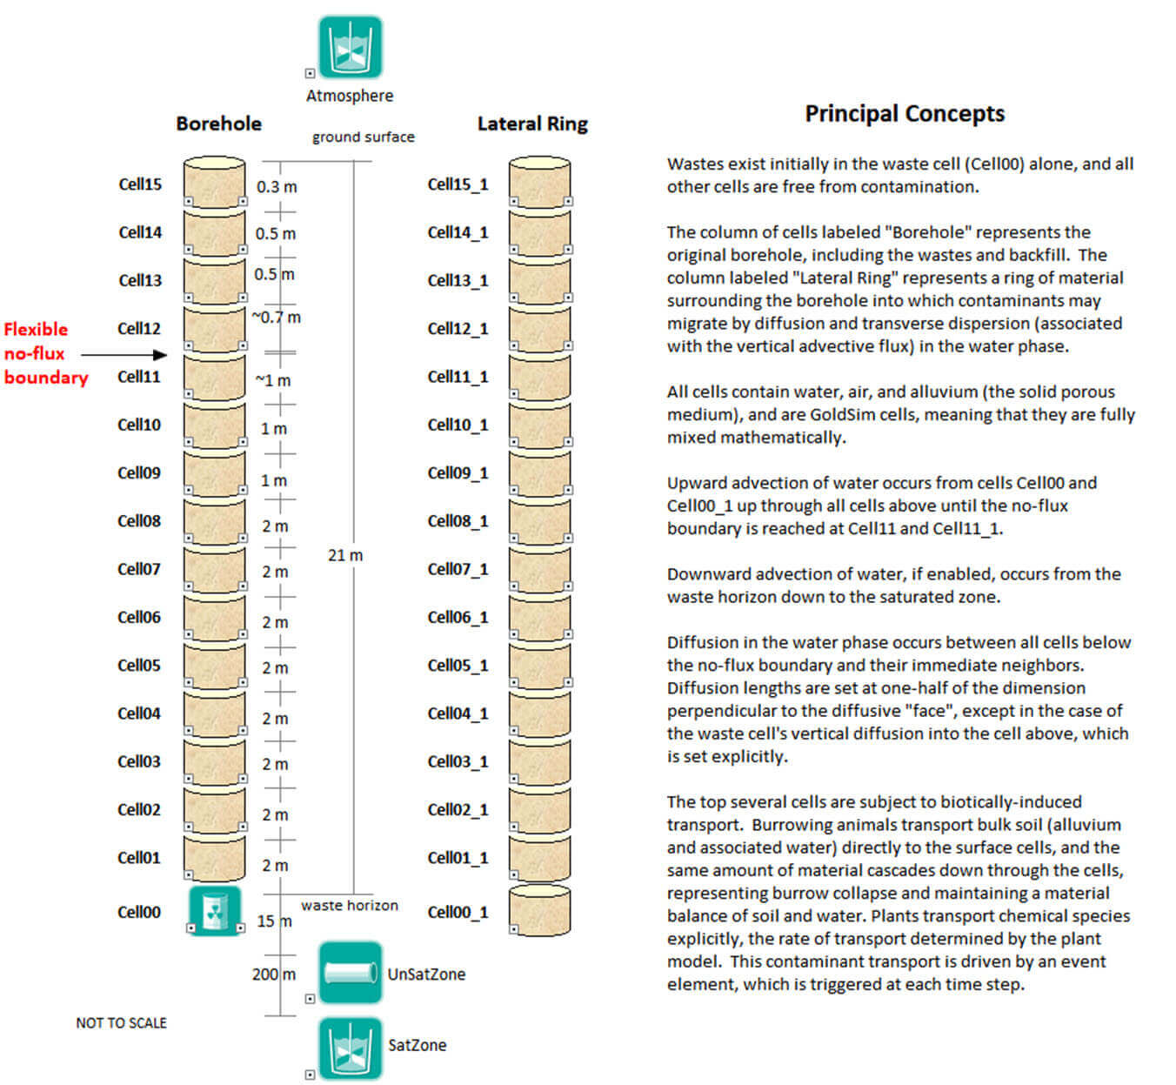
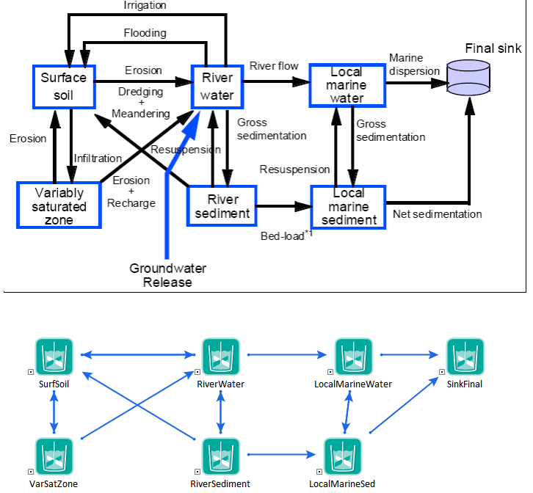
Cells Can Represent Any Geometry

Slide 41
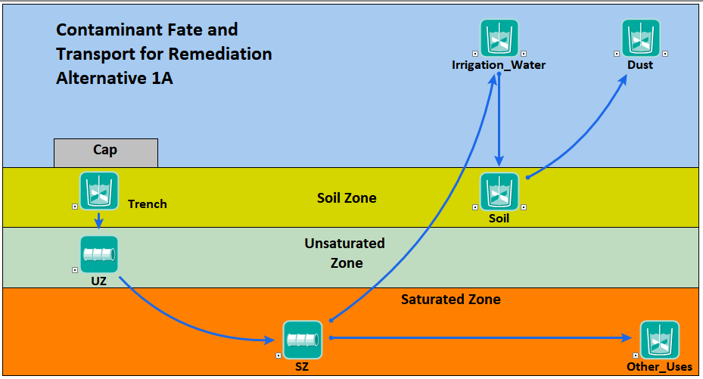
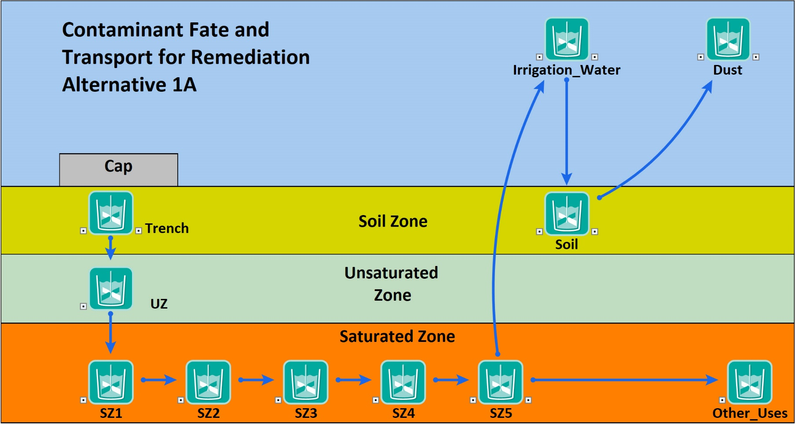
How to Model Dispersion?
Aquifer Pathways

Slide 42
Aquifer Pathway Element
Internally, GoldSim uses a series of Cells to create the Aquifer Pathway.
The Aquifer Pathway incorporates:
one-dimensional advection
longitudinal dispersion
Retardation (due to porous infill)
Decay and ingrowth
Transport on suspended particulates

Slide 43
Example5: Cylinder - Aquifer Pathway
Horizontal cylinder filled with water and sand
Water flows through column at a fixed rate
Cl and Organic added at a constant rate
Organic partitions onto the sand (Cl does not)

Slide 44
Combining Cells and Aquifers

Slide 45
Coupling Flow and Transport Models
If the Flow is steady, no reason to model the flow system
If flow is transient, must couple these
Use Reservoirs or Pools and Material Delays to model flow system
Outputs of these elements are input to CT elements

Slide 46
This is only the tip of the iceberg…
Many advanced features not discussed here:
Transport on suspended particulates
Water treatment (e.g., remove a certain fraction of incoming mass from a Cell)
Other transport mechanisms (neither advective or diffusive): plant transport
Matrix diffusion in fractures
Linking to external transport models
Simulation of complex source terms (the Source element)

Slide 47
Summary
The Contaminant Transport Module is a complex and powerful add-on module for GoldSim
You can create extremely complex multi-dimensional models using only Cells and Aquifers
Not intended to build highly discretized models
In many cases, it can be argued that this is not necessary or appropriate
Best way to learn:
User Manual
Example models in Model Library
Online Course (currently under construction)

Slide 48
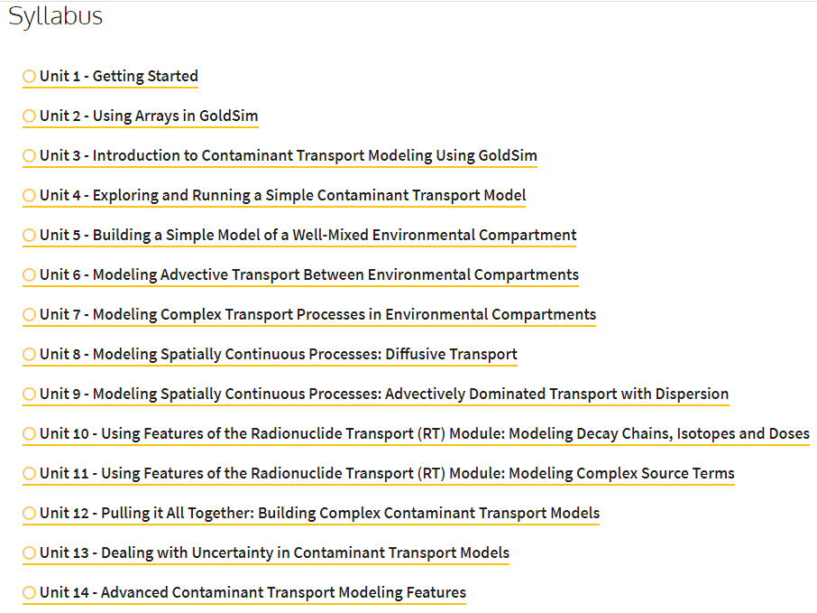

Slide 49
Questions?

