Slide 1
Simulating Flow Control
June 2025 GoldSim Webinar
By Jason Lillywhite

Slide 2
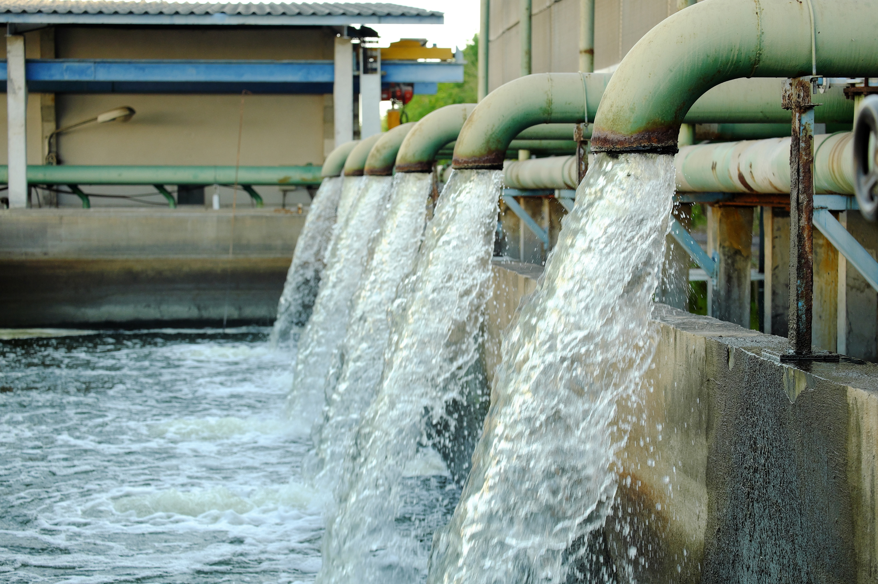
What Is Flow Control?
Flow control is the process of actively managing the movement of water, energy, or materials through a system to maintain desired conditions.
It is used to:
  Maintain target levels (e.g., water in a reservoir, pressure in a pipe)
  Respond to changing conditions in real time
  Ensure system stability, safety, and efficiency
Common in:
  Water resource systems
  Industrial operations
  Environmental and energy systems

Slide 3
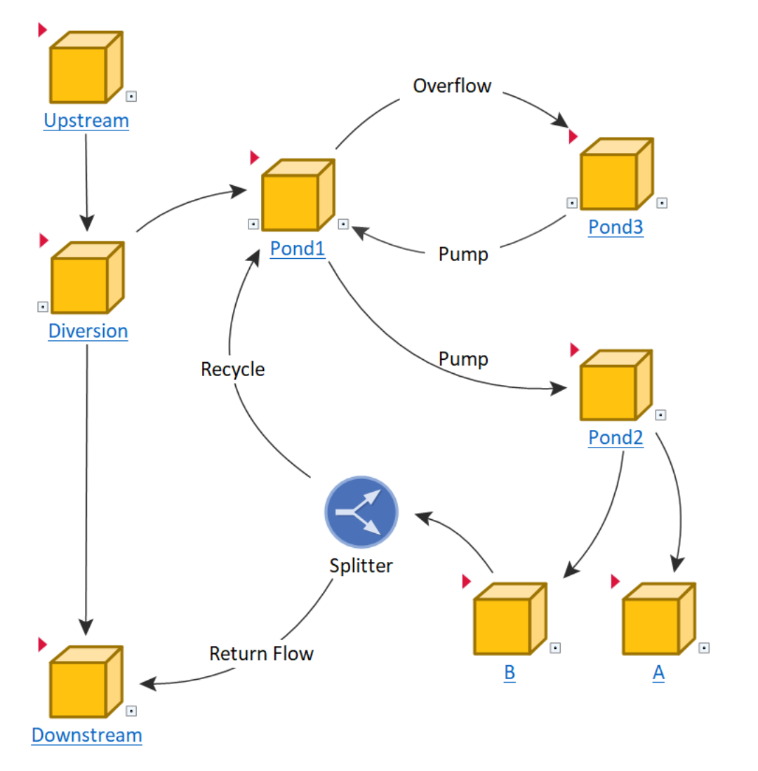
Real-World Application: Water Balance Model
Model demonstration…

Slide 4
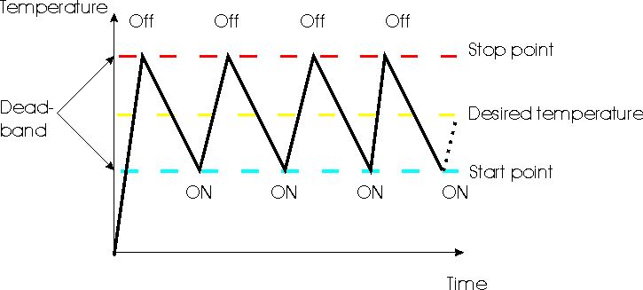
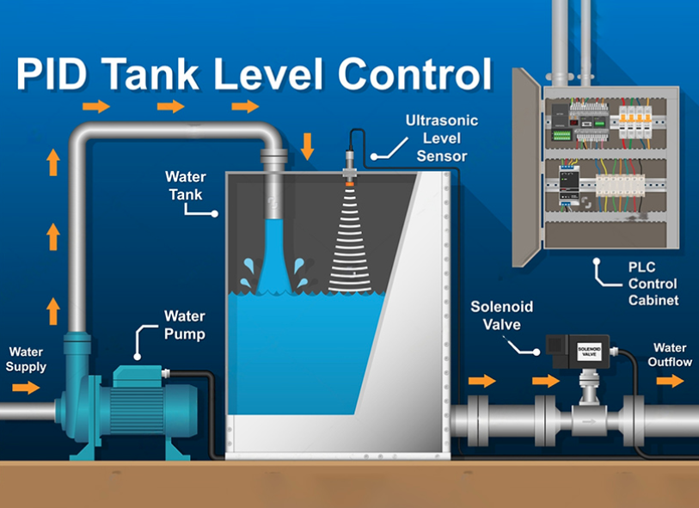
Example Use Cases
Home thermostat (70° F set point)
  Heating turns on only if the temperature drops below 68°F.
  Heating stops if it rises above 72°F.
  No action is taken between 68–72°F.
PID Tank Level Control
  Maintains a precise temperature by adjusting fuel flow.
  Reacts not only to current error but also to how fast the temperature is changing and how long it has been off-target.
Image source: xtronics.com
Image source: effykon.com

Slide 5
Feedback Control
Feedback control is a process where a system continuously monitors its output and adjusts its inputs to maintain a desired target or setpoint.
State Variable: What you want to control (e.g., pond level)
Controller: The logic that adjusts flows or actions
Target: The desired value or range
Feedback Loop: The system’s response to deviations
Controller
Controller Output
Target
Error
Controller Properties
Process

Slide 6
Direction of Flow
User must choose this before running the model. This will affect the direction of the response in the controller.
Outflow Controller: Removes material when the process variable is too high.
Inflow Controller: Adds material when the process variable is too low.
Inflow Type
Pump
Outflow Type
Process variable increasing
Process variable increasing
Controller output: Reduced signal
Pump
Controller output: Increase signal

Slide 7
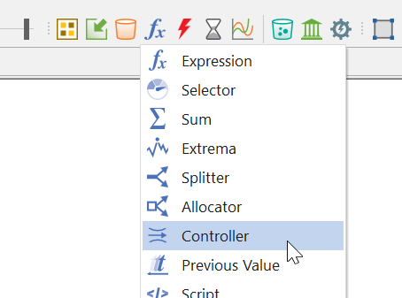
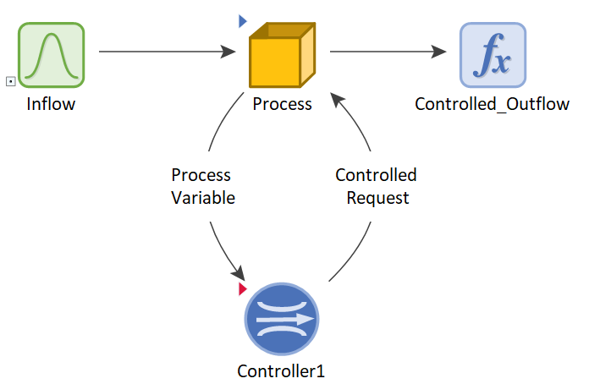
Introducing the Controller Element
What is it?
  New in GoldSim 15.
  Designed to simulate feedback control systems.
Why it matters:
  Replaces complex logic with a single, intuitive element.
  Supports Deadband, Proportional, and PID control.
  Applicable across domains: water, energy, finance, etc.

Slide 8
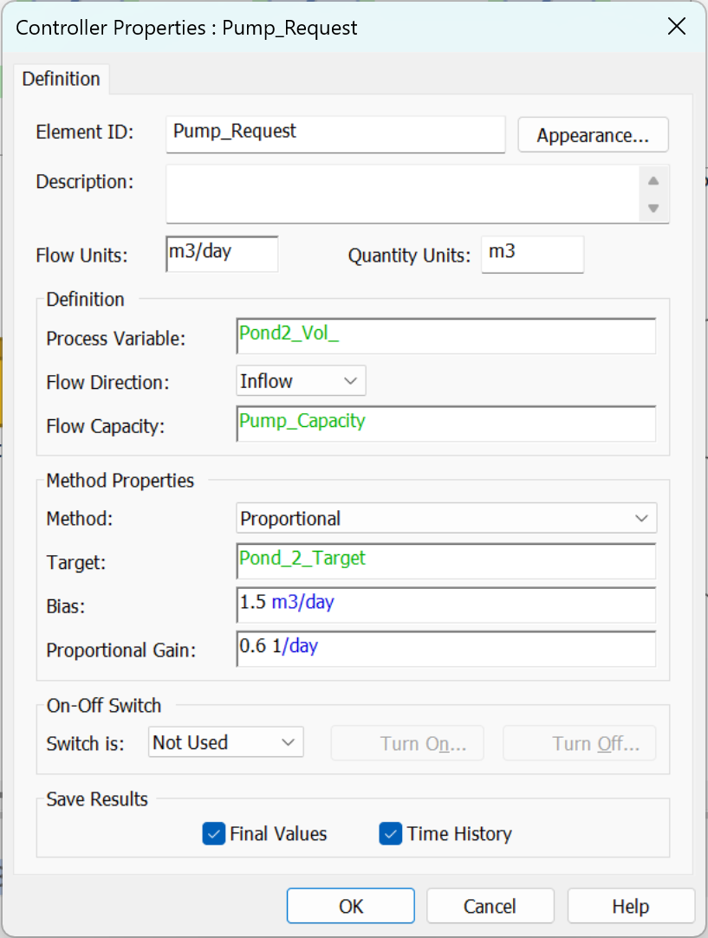
Controller Properties
Flow and Quantity Units
Process Variable
Flow Direction
Flow Capacity
Method
Target
Bias

Slide 9
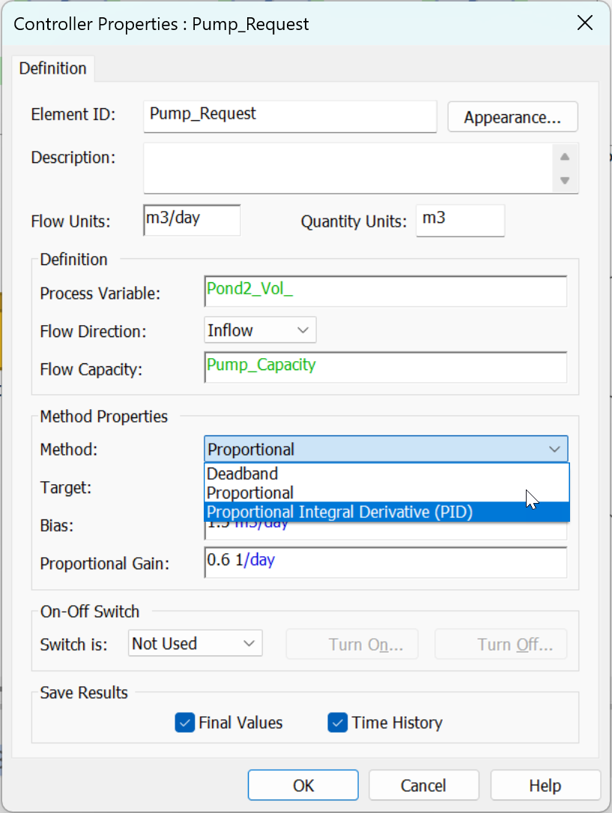
Types of Control
Choose the type before running the model
Choices:
  Deadband
  Proportional
  Proportional-Integral-Derivative (PID)

Slide 10
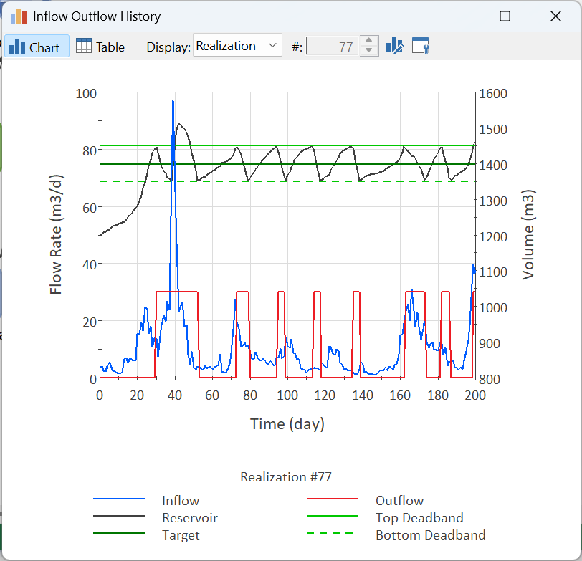
Dead Band Control
Inputs
  Process Variable, Target, Direction, Max Flow capacity
  Target, Deadband Thickness, Target Position

Slide 11
Target Position
Center
Top
Bottom
Top
Top
Target
Top
Dead Band
Target
Bottom
Bottom
Bottom
Target

Slide 12
Proportional Control
Inputs
  Process Variable, Target, Direction, Max Flow capacity, Bias
  Proportional Gain Constant (Prop_Gain)
Output
  Min(max(Bias + Prop_Gain * Error, 0), Max flow)
  Proportional gain has dimensions of Bias / (error * time)

Slide 13
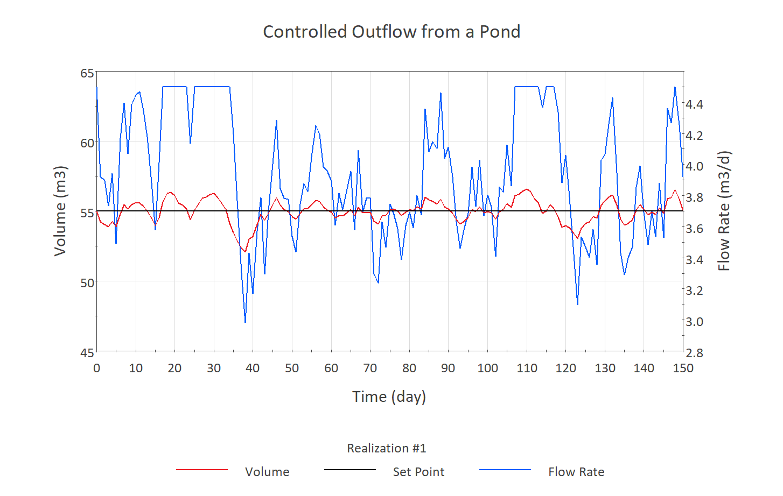
PID Controller
Inputs
  Process Variable, Target, Direction, Max Flow capacity, Bias
  Tuning Factors:
    Proportional Gain (Prop_Gain) (1/T)
    Derivative Time Constant (Ti) (T)
    Integral time constant (Td) (1/T)
Output
  Output = min(max(P + I + D + Bias, 0), Max Flow)
  P = Prop_Gain * Error
  I = Error_Integral / Ti
  D = Td * (Error – Error_pv)

Slide 14
Model Demonstrations
Compare outputs of different types

Slide 15
Best Practices & Resources
When to use each control method.
Tips for tuning and testing.
Highlight learning resources:
  Help Documentation
  Online Course
  Model Library

Slide 16
Questions?

