Slide 1
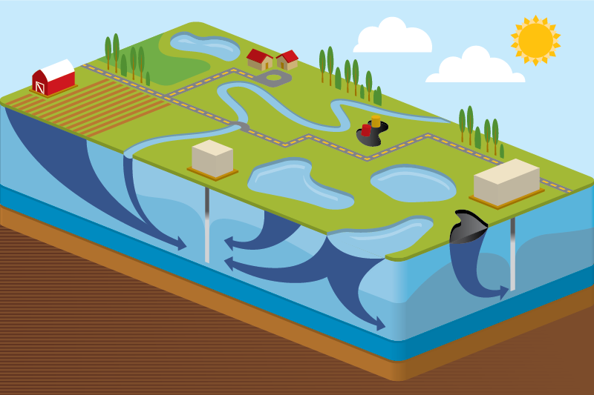
Modeling Contaminant Concentrations in Ponds and Reservoirs
Rick Kossik (rkossik@goldsim.com)

Slide 2
Outline
This will be an introduction to using the GoldSim Contaminant Transport Module to model contaminant concentrations in ponds and reservoirs.
We will first provide a very brief introduction to the Contaminant Transport Module for those who are not familiar with it.
We will then walk through a number of simple examples.
We will close by addressing a number of more complex issues (e.g., dealing with solubility constraints, dealing with ponds that dry out, modeling travel times between ponds).

Slide 3
Overview of the Contaminant Transport Module

Slide 4
GoldSim and the Contaminant Transport Module
The basic GoldSim framework consists of a flexible set of tools for creating dynamic, probabilistic simulations of nearly any kind of complex system.
These tools are very abstract (like a programming language)
They simply carry out mathematical calculations (e.g., numerical integration) that are applicable to many types of problems.
In order to simulate some kinds of complex systems, such tools are not sufficient. Therefore, GoldSim has several specialized extension modules to facilitate simulation of some types of systems.
The Contaminant Transport Module is a set of specialized tools that are added to GoldSim to support complex contaminant transport simulations.

Slide 5
GoldSim and the Contaminant Transport Module
The module is used to simulate the movement of mass (typically contaminants) through natural (and engineered) systems.
It produces predictions of mass transport rates at defined locations, concentrations in specified environmental media (e.g., water, soil), and impacts to defined human receptors (e.g., dose, health risk).
Processes that can be simulated include mixing, solubility constraints, sorption, advection, dispersion, diffusion, and chemical reactions and radioactive decay and ingrowth.
This webinar will focus on tracking contaminants in ponds and reservoirs.

Slide 6
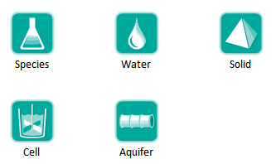
Contaminant Transport Module
Adds specialized elements to facilitate simulation of contaminant transport through engineered and natural environmental systems

Slide 7
Contaminant Transport Module
Provides a basic framework for modeling fate and transport of dissolved, sorbed and/or suspended contaminants through engineered and natural systems.
Complexity of the model is determined by the user.
While incorporating some basic physics (e.g., conservation of mass, decay and ingrowth, diffusion, partitioning), very few assumptions built into code in order to maximize flexibility.
Heavily utilizes arrays.

Slide 8
Steps for Modeling Contaminant Transport
Specify species to be modeled.
Specify the transport and storage media within the system to be modeled (e.g., water, air, sediment, soil).
Specify the transport pathways through which mass is transported and stored.
Define the source terms (initial and/or boundary conditions).
Define the impacts of the species (e.g., dose) on defined receptors.

Slide 9
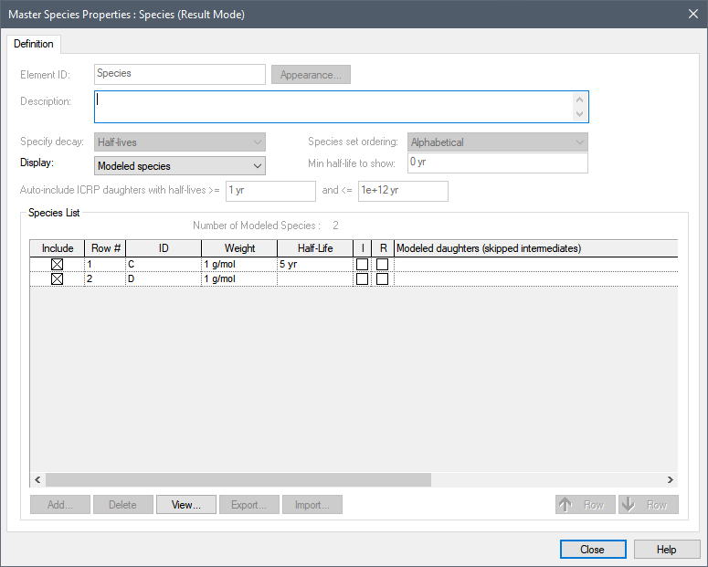
Defining Species
Species element

Slide 10
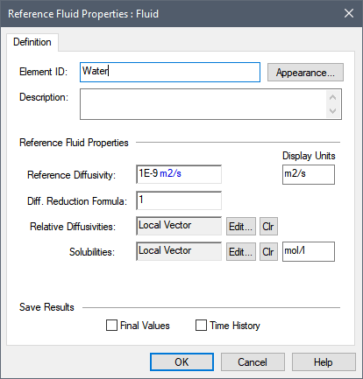
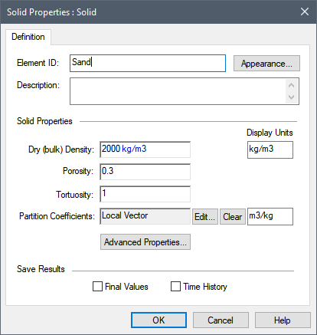
Environmental Media
Basic “building blocks” of transport pathways
Mass transport calculations are based largely on media properties
Two types: Fluids and Solids

Slide 11
Transport Pathways
Transport pathways represent those parts of the system through which species mass is transported and/or in which species mass is stored.
Tanks, ponds, aquifers, lakes, soil columns, etc.
You define the properties of the pathways, such as geometry, volume, and pathway discretization.
You define which media (e.g., air, water, sediments, rock) types are present in the pathway.

Slide 12
Transport Pathways
Pathways can be thought of as transfer functions.
Each pathway type (or transfer function) assumes or represents a particular range of physical transport processes.

Slide 13
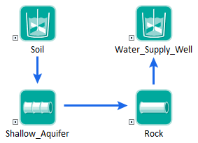
Transport Pathways
You create a mass transport system by defining a network of transport pathways using mass flux links among the pathways.

Slide 14
Transport Pathways
GoldSim provides five type of pathways:
We will focus on Cells today to do simple mixing, and will only very briefly mention Aquifers

Slide 15
Cell Pathways
Act as mixing cells
Specify multiple media
always contains a single reference fluid
Mass is instantly mixed and equilibrated (partitioned between media) within cell
Solubility constraints can be imposed in cell
Can have specified initial/boundary condition
Behavior of cell network is mathematically equivalent to network of finite difference nodes

Slide 16
Pathways Mass Balance
Species mass is conserved.
The Contaminant Transport Module simulates mass transport so it solves for the mass of each species in each transport pathway.
The water, or other media, balance is not a part of the transport module solution.
Media amounts and advection rates are inputs for transport pathways.
You can link the transport media amounts and advection rates to a water balance model (or other media balance model) in order to enforce both a water balance and species mass balance.

Slide 17
Let’s Look at Some Simple Models

Slide 18
Example 1: Simple Mixing of Two Inflows
40 m3/day
10 g/m3 X
5 g/m3 Y
100 m3/day
60 m3/day
2 g/m3 X
4 g/m3 Y
Initial Volume: 100 m3
Initial Concentration of X and Y: 0 g/m3

Slide 19
Equations Solved by GoldSim
$\frac{dm}{dt}=−QC$+ $Input Rate$
$$C=\frac{m}{V}$$
We have assumed Q and V to be constant, but as we shall see, they don’t have to be…

Slide 20
Example 2: Simple Mixing of Two Inflows
40 m3/day
10 g/m3 X
5 g/m3 Y
100 m3/day
60 m3/day
2 g/m3 X
4 g/m3 Y
Initial Volume: 100 m3
Initial Concentration X: 10 g/m3
Initial Concentration Y: 3 g/m3

Slide 21
Example 3: Understanding How Quickly Pond Concentrations Respond to Changes
The concentrations in a pond have “inertia”. How quickly they respond to changes in incoming concentrations (and in this simple example, reach a steady state) is a function of long it takes the pond to “turn over”
Volume/Flow Rate
Let’s examine the behavior as a function of the pond volume
We will vary the Volume for the previous example from 10 m3 to 1000 m3 (as different scenarios)
We will also cut the incoming concentrations in half at 50 days.

Slide 22
Changing Flow Rates and Volumes
The previous examples treated the Cell as having constant volume.
But in the real world this would rarely be the case.
To model changing Cell volumes, we need to use a Reservoir or Pool to track the volume, and link this to the Cell as an input

Slide 23
Example 4: Variable Inflows and Volume
Noisy with mean of 40 m3/day
10 g/m3
100 m3/day
Noisy with mean of 60 m3/day
2 g/m3
Initial Volume: 100 m3, 500 m3, 1000 m3 (scenarios)
Initial Concentration X: 0 g/m3

Slide 24
Understanding Mixing in Cells
The scenario with an initial volume of 1000 m3 “smoothed” out the variations in the mass inflows. It did this because the mass entering was assumed to be instantaneously mixed throughout the pond.
This may be realistic for a small pond/reservoir, but as they get larger this may be an unrealistic assumption.
To manage a situation like this, it is necessary to discretize the pond.

Slide 25
Example 5: Discretizing a Pond/Reservoir
The mixing rate between the upper and lower levels of the pond determines its behavior.
We will look at several scenarios in which we vary this rate.

Slide 26
Equations Solved by GoldSim
$\frac{dm_{1u}}{dt}=−Q_{mix}C_{1u}$ +$Q_{mix}C_{1l }−QC_{1u} \text{+}\text{Input}$
$\frac{dm_{1l}}{dt}=−Q_{mix}C_{1l}$ +$Q_{mix}C_{1u }$
$\frac{dm_{2}}{dt}=QC_{1u}$ $−$ $QC_{2}$
$$C_{i}=\frac{m_{i}}{V_{i}}$$

Slide 27
Partitioning of Species Between Fluids and Solid
GoldSim can simulate equilibrium partitioning of species between water and solids.
Like mixing, partitioning is assumed to be instantaneous (so care must be taken to ensure that this is realistic).
Solids can be assumed to be assumed to be stationary or suspended in the water.
Partitioning onto a solid phase can greatly impact transport.

Slide 28
Example 6: Partitioning of Species Between Fluids and Solids in a Pond
100 m3/day
No incoming concentration
100 m3/day
Initial Volume of Water: 100 m3
Mass of Sediment: 100 kg
Initial Mass of X and Y: 1000 g
X DOES NOT partition on the sediment
Y DOES partition onto the sediment

Slide 29
Equations Solved by GoldSim
$\frac{dm}{dt}=−QC$+ $Input Rate$
$$C=\frac{m}{V+M_{sediment}K_{sediment/water})}$$

Slide 30
Example 7: Partitioning of Species Between Fluids and Suspended Solids in a Pond
100 m3/day
No incoming concentration
100 m3/day
Initial Volume of Water: 100 m3
Mass of Sediment: 100 kg
Sediment is suspended
Initial Mass of X and Y: 1000 g
X DOES NOT partition on the sediment
Y DOES partition onto the sediment

Slide 31
Modeling Solubility Constraints
Many species have solubility constraints (they precipitate out of solution at high concentrations, forming a solid).
In some cases representing this kind of process in a pond or reservoir requires detailed geochemical modelling (e.g., linking GoldSim dynamically to a code like PHREEQC).
In some cases, however, you can use a simpler approach in which you simply specify a solubility limit for a species. GoldSim supports this.

Slide 32
Example 8: Modeling a Solubility Constraint
0.2 m3/day
0.2 m3/day
X and Y are released into pond at a rate of 10 g/day for first 40 days (then 0)
Volume of Water: 10 m3
X has a solubility limit (15 g/m3); Y does not

Slide 33
The Problem of Emptying Cells
In some systems (e.g., small ponds at mines), the pond can actually go dry for some periods.
Warning: if this is happening with a complex mixture of species due to evaporation, the geochemistry is likely to be very complex (many solids will be precipitating out of solution)!
Nevertheless, in some cases, you may just want to ignore this geochemistry, but allow ponds to occasionally go dry.
However, this can cause numerical problems for GoldSim, so special action needs to be taken to simulate it properly.
Discussed in detail in the Help system and User’s Guide.

Slide 34
Example 9: Modeling a Pond Going Empty
0.4 m3/day for t < 150 days,
0.6 m3/day for t >= 150 days and < 250 days
0.2 m3/day for t >= 250 days
0.4 m3/day
X at a concentration of 100 g/m3
Initial Volume of Water: 10 m3

Slide 35
Delayed Transport Between Ponds/Reservoirs
In many cases, the travel time between ponds/reservoirs (represented by Cells) will be effectively instantaneous (relative to your timestep).
In some cases, however, there may be a significant travel time between one location and the next (e.g., a pond leaks into an aquifer which eventually discharges to a pond or stream).
In these cases, you can use Aquifer elements to represent such systems.

Slide 36
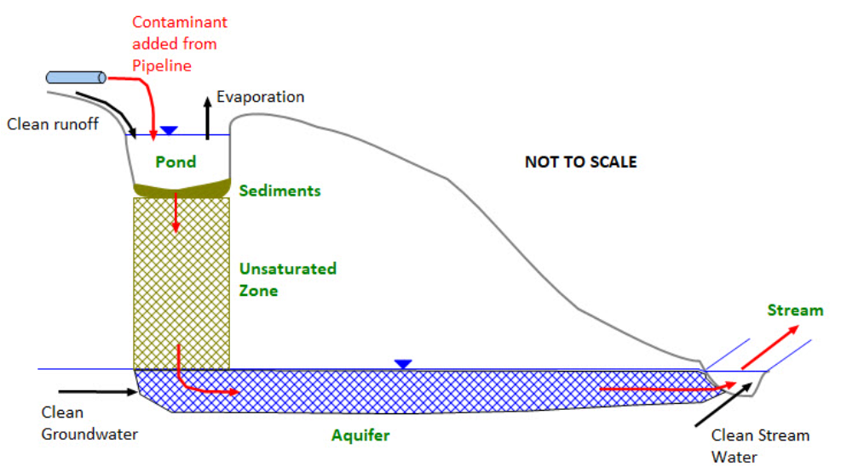
Example 10: Delayed Transport Between Ponds/Reservoirs

Slide 37
Summary
The Contaminant Transport Module can be used to model the transport of contaminants between ponds and reservoirs (using Cell pathways).
In most cases, you will need to couple the Cell pathways to Reservoir or Pool elements that you are using for your water balance (to represent the dynamic nature of the flow system).
In some cases, you may simply want to model the mixing of contaminants.
In others, you may want to represent more complex processes (e.g., partitioning, transport on suspended solids, solubility constraints).
You can create extremely complex multi-dimensional models by using combinations of Cell and Aquifer pathways.

Slide 38
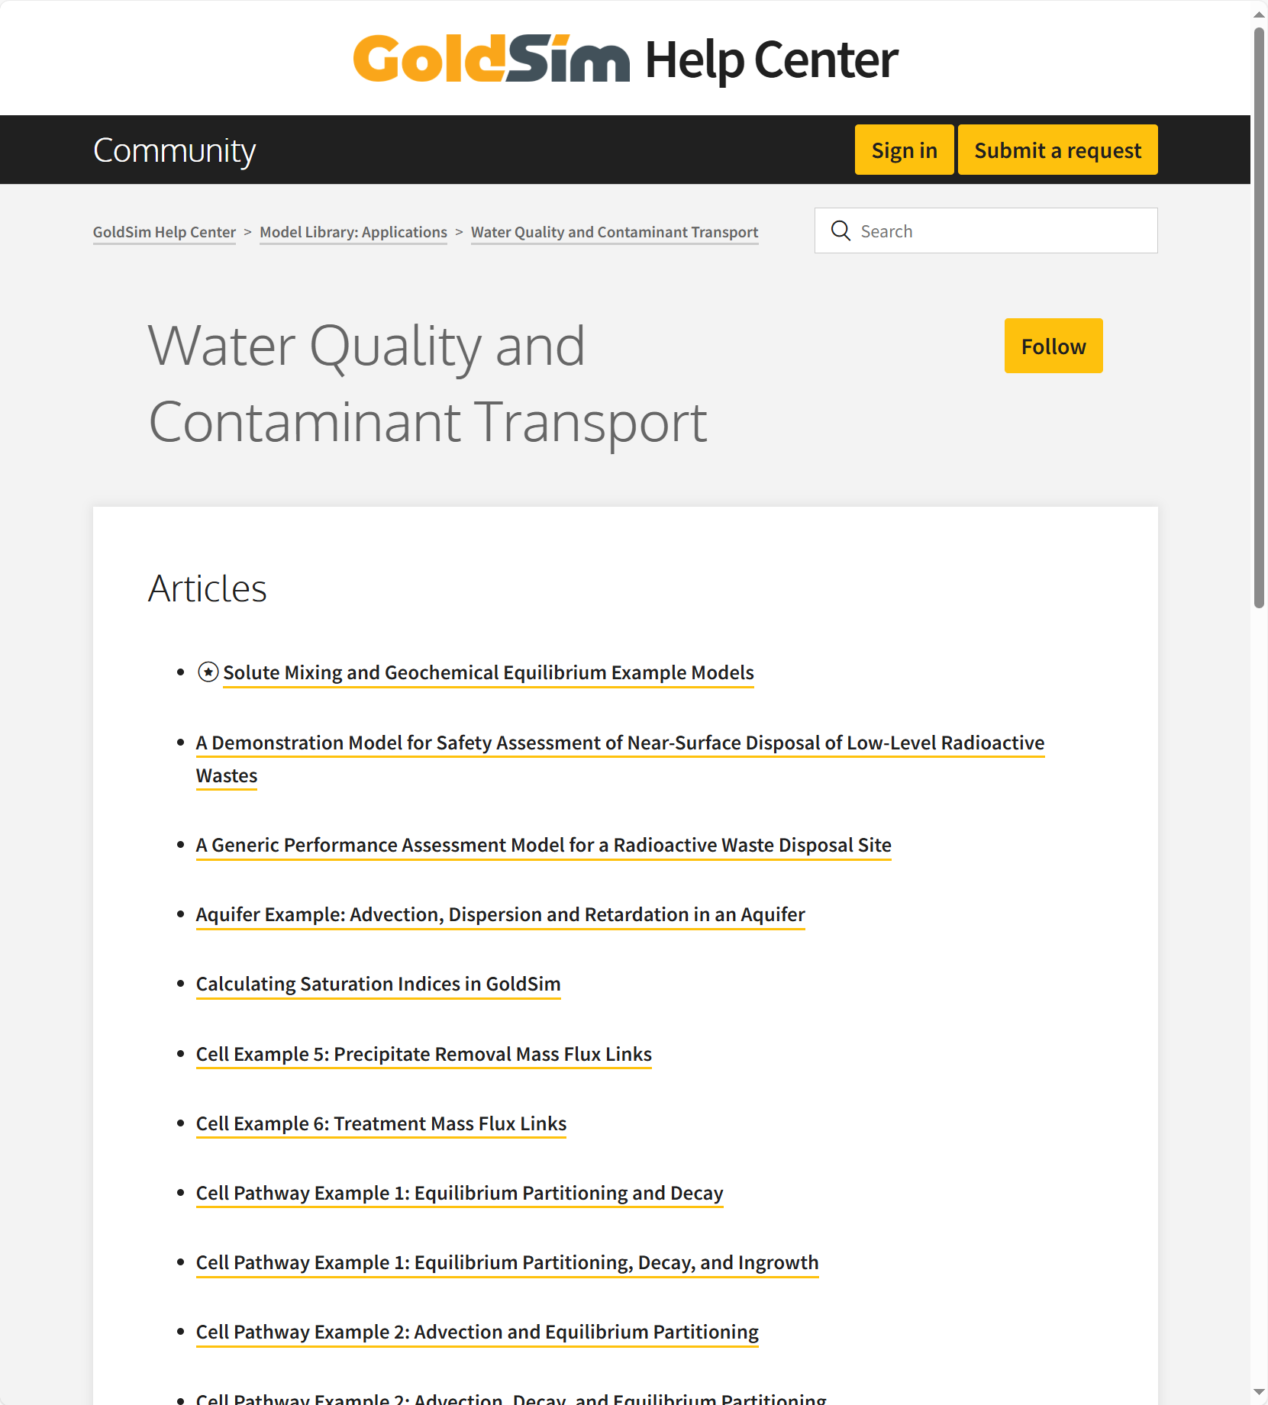
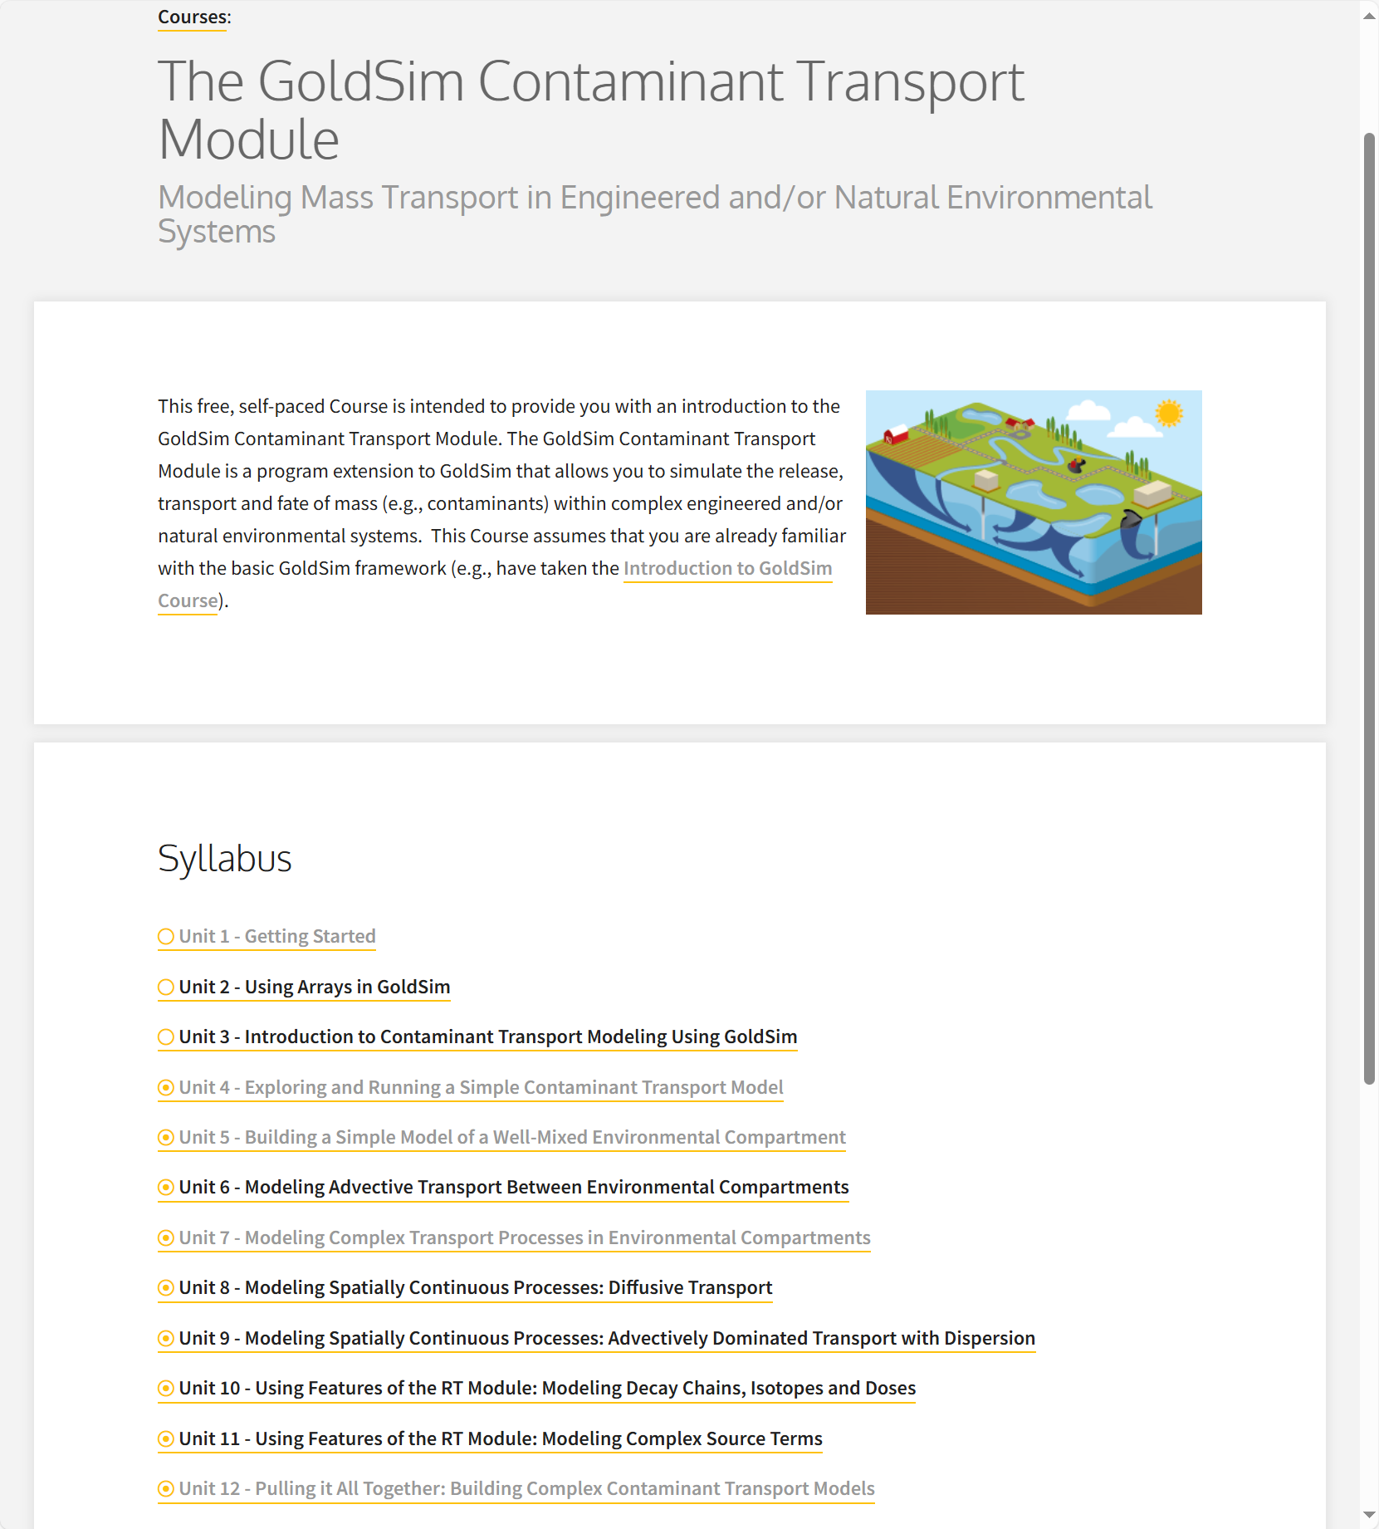
Learn More
Take the Online Course
Example models in Model Library
Send questions to GoldSim

