Slide 1
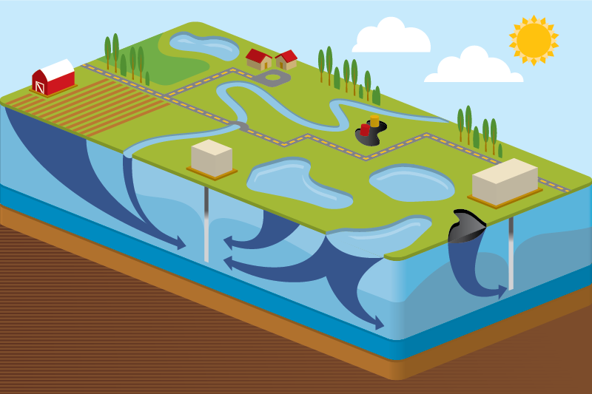
Simple Mixing Using the Contaminant Transport Module
Rick Kossik
rkossik@goldsim.com

Slide 2
GoldSim and the Contaminant Transport Module
The basic GoldSim framework consists of a flexible set of tools for creating dynamic, probabilistic simulations of nearly any kind of complex system
These tools are very abstract (like a programming language)
They simply carry out mathematical calculations (e.g., numerical integration) that are applicable to many types of problems
It is assumed you are familiar with the basic GoldSim framework
In order to simulate some kinds of complex systems, such tools are not sufficient. Therefore, GoldSim has several specialized extension modules to facilitate simulation of some types of systems
The Contaminant Transport Module is a set of specialized tools that are added to GoldSim to support complex contaminant transport simulations

Slide 3
GoldSim and the Contaminant Transport Module
The module is used to simulate the movement of mass (typically contaminants) through natural (and engineered) systems
Produces predictions of mass transport rates at defined locations, concentrations in specified environmental media (e.g., water, soil), and impacts to defined human receptors (e.g., dose, health risk)
Processes that can be simulated include mixing, solubility constraints, sorption, advection, dispersion, diffusion, and chemical reactions and radioactive decay and ingrowth
This webinar will focus on simple mixing

Slide 4
Overview of the Contaminant Transport Module

Slide 5
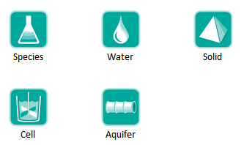
Contaminant Transport Module
Adds specialized elements to facilitate simulation of contaminant transport through engineered and natural environmental systems

Slide 6
Contaminant Transport Module
Provides a basic framework for modeling fate and transport of dissolved, sorbed and/or suspended contaminants through engineered and natural systems
Complexity of the model is determined by the user
While incorporating some basic physics (e.g., conservation of mass, decay and ingrowth, diffusion, partitioning), very few assumptions built into code in order to maximize flexibility
Heavily utilizes arrays

Slide 7
Steps for Modeling Contaminant Transport
Specify species to be modeled
Specify the transport and storage media within the system to be modeled (e.g., water, air, sediment, soil)
Specify the transport pathways through which mass is transported and stored
Define the source terms (initial and/or boundary conditions)
Define the impacts of the species (e.g., dose) on defined receptors

Slide 8
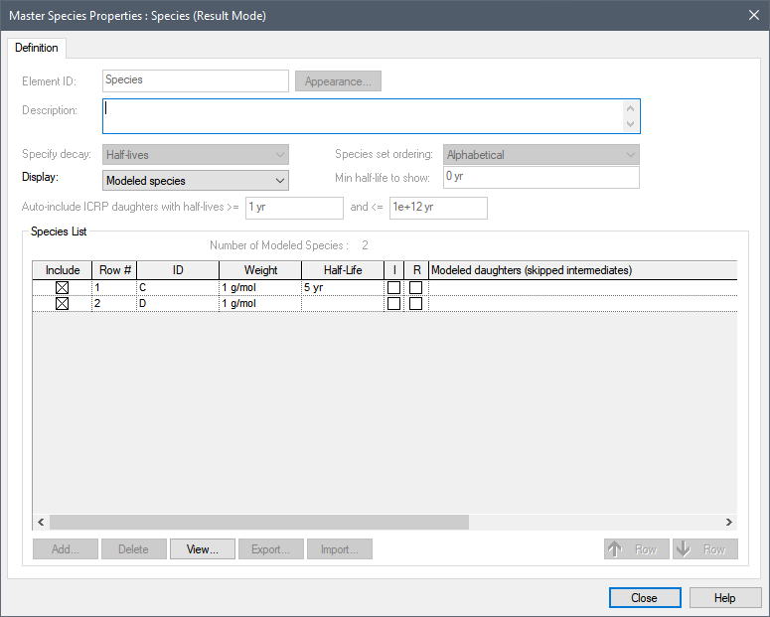
Defining Species
Species element

Slide 9
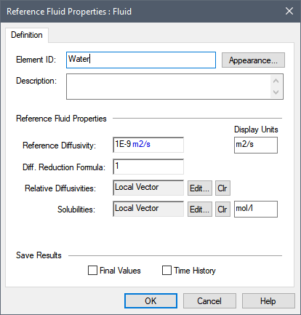
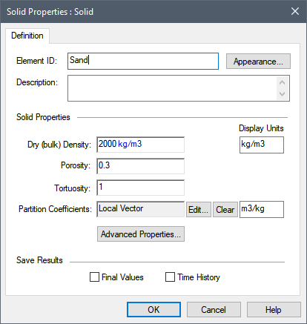
Environmental Media
Basic “building blocks” of transport pathways
mass transport calculations are based largely on media properties
Two types: Fluids and Solids

Slide 10
Transport Pathways
Transport pathways represent those parts of the system through which species mass is transported and/or in which species mass is stored.
Tanks, ponds, aquifers, lakes, soil columns, etc.
You define the properties of the pathways, such as geometry, volume, and pathway discretization.
You define which media (e.g., air, water, sediments, rock) types are present in the pathway

Slide 11
Transport Pathways
Pathways can be thought of as transfer functions
Each pathway type (or transfer function) assumes or represents a particular range of physical transport processes.

Slide 12
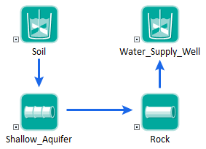
Transport Pathways
You create a mass transport system by defining a network of transport pathways using mass flux links among the pathways.

Slide 13
Transport Pathways
GoldSim provides five type of pathways:
We will focus on Cells today to do simple mixing
We will also only consider water (no partitioning onto solids)

Slide 14
Pathways Mass Balance
Species mass is conserved.
The Contaminant Transport Module simulates mass transport so it solves for the mass of each species in each transport pathway.
The water, or other media, balance is not a part of the transport module solution.
Media amounts and advection rates are inputs (and not solution values) for transport pathways.
You can link the transport media amounts and advection rates to a water balance model (or other media balance model) in order to enforce both a water balance and species mass balance.

Slide 15
Let’s Look at Some Simple Mixing Models

Slide 16
Cell Pathways
Act as mixing cells
Specify multiple media
always contains a single reference fluid
Mass is instantly mixed and equilibrated (partitioned between media) within cell
Solubility constraints can be imposed in cell
Can have specified initial/boundary condition
Behavior of cell network is mathematically equivalent to network of finite difference nodes
We are not going to address multiple media or solubility today; just simple mixing

Slide 17
Example1: Two Inflows into a Well-Mixed Flow-Through Tank
Tank holds 10 m3 of water
Initially concentration in the tank is 0 g/m3
4 m3/day of water with concentration of X of 10 g/m3 enters
6 m3/day of water with concentration of X of 2 g/m3 enters
10 m3/day of water leaves (volume stays constant)

Slide 18
Example2: Two Inflows into a Well-Mixed Flow-Through Tank
Tank holds 10 m3 of water
Initially concentration in the tank is 20 g/m3
4 m3/day of water with concentration of X of 10 g/m3 enters
6 m3/day of water with concentration of X of 2 g/m3 enters
10 m3/day of water leaves (volume stays constant)

Slide 19
Example3: Two Inflows into a Well-Mixed Flow-Through Tank
Vary tank volume from 0.1 m3 to 100 m3
Initially concentration in the tank is 0 g/m3
4 m3/day of water with concentration of X of 10 g/m3 enters
6 m3/day of water with concentration of X of 2 g/m3 enters
10 m3/day of water leaves (volume stays constant)

Slide 20
Example4: Two Inflows into a Well-Mixed Flow-Through Tank
Small tank volume of 0.1 m3 (responds instantaneously)
Initially concentration in the tank is 0 g/m3
~4 m3/day (stochastic) of water with concentration of X of 10 g/m3 enters
~6 m3/day (stochastic) of water with concentration of X of 2 g/m3 enters
Same amount of water that enters leaves (volume stays constant)
This is analogous to computing the concentration at a point in a river where two streams meet (the point at which the two streams are instantaneously mixed)

Slide 21
Example5: Two Inflows into a Well-Mixed Flow-Through Tank
Small tank volume of 0.1 m3 (responds instantaneously)
Initially concentration in the tank is 0 g/m3
~4 m3/day (stochastic) of water with concentration of X of 10 g/m3 and concentration of Y of 1 g/m3 enters
~6 m3/day (stochastic) of water with concentration of X of 2 g/m3 and concentration of Y of 3 g/m3 enters
Same amount of water that enters leaves (volume stays constant)
This is analogous to computing the concentration at a point in a river where two streams meet (the point at which the two streams are instantaneously mixed): Example6

Slide 22
Example7
Assume 6 g/day of X is added to Pond1 for 5 days
Assume 10 g/day of X is added to Pond1 for 10 days
All ponds contain constant volume of 100 m³ of Water (hence, does not turn over immediately); the ponds are well-mixed
Water overflows from Pond1 and Pond2 to Pond3 and then out of system (to a “sink” Cell)
5 m3/day “Clean” water
Pond1
6 g/day added for 5 days
Pond2
Pond3
Sink
5 m3/day “Clean” water
10 m3/day
10 g/day added for 10 days

Slide 23
Equations Solved by GoldSim
$\frac{dm_{1}}{dt}=−Q_{1}C_{1}$ + ${Input}_{1}$
$\frac{dm_{2}}{dt}=−Q_{2}C_{2}$ + ${Input}_{2}$
$\frac{dm_{3}}{dt}=Q_{1}C_{1}$ + $Q_{2}C_{2}$- $Q_{3}C_{3}$
$$C_{i}=\frac{m_{i}}{V_{i}}$$
We have assumed Q and V to be constant, but they don’t have to be…

Slide 24
Changing Flow Rates and Volumes
The previous examples treated the Cell(s) as having constant volume
This is because physically, they represented the following:
A true constant volume entity (e.g., an overflowing tank or pond); or
An infinitesimal slice of a system (e.g., the end of a reach in a stream)
But what if we wanted to compute mixing in a series of ponds or lakes (whose volume was not constant)?

Slide 25
Example8
Assume 6 g/day of X is added to Pond1 for 5 days
Assume 10 g/day of X is added to Pond1 for 10 days
Pond1 and Pond2 have a constant volume of 100 m³ of Water (water overflows to Pond3)
Pond3 starts with 100 m3 of water. A pump turns on whenever volume exceeds 150m3 and turns off again when it is down to 100 m3 (and pumps at a rate of 15 m3/day)
5 m3/day “Clean” water
Pond1
6 g/day added for 5 days
Pond2
Pond3
Sink
5 m3/day “Clean” water
variable
10 g/day added for 10 days

Slide 26
Summary
The Contaminant Transport Module can be used to easily carry out mixing calculations
For simple systems, could do this without CT Module (with some additional effort)
Mixing calculations in GoldSim generally fall into two categories
Computing concentrations at a specific point (e.g., in a river)
Assume small constant volume
Computing average concentrations in ponds or reservoirs
Often need to model volume changes and slow turnover rates
Do this by linking to flow model (e.g., made up or Pool or Reservoir elements)
Note that volume should change slowly over a timestep to avoid numerical issues
What we have discussed here is very simple; the CT Module can do much more (e.g., solubility, partitioning, decay)
But for many applications, a simple mixing model is appropriate

Slide 27
Learn More
The Contaminant Transport Module is a complex and powerful add-on module for GoldSim
You can create extremely complex multi-dimensional models
Not intended to build highly discretized models
In many cases, it can be argued that this is not necessary or appropriate
Best way to learn:
User Manual
Example models in Model Library
Online Course (currently under construction)
Send questions to GoldSim

