Slide 1
Designing Well-Structured and Scalable Models
April 2015 Webinar

Slide 2
Overview
Design
Implementation
Documentation
Validation and review
Presentation

Slide 3
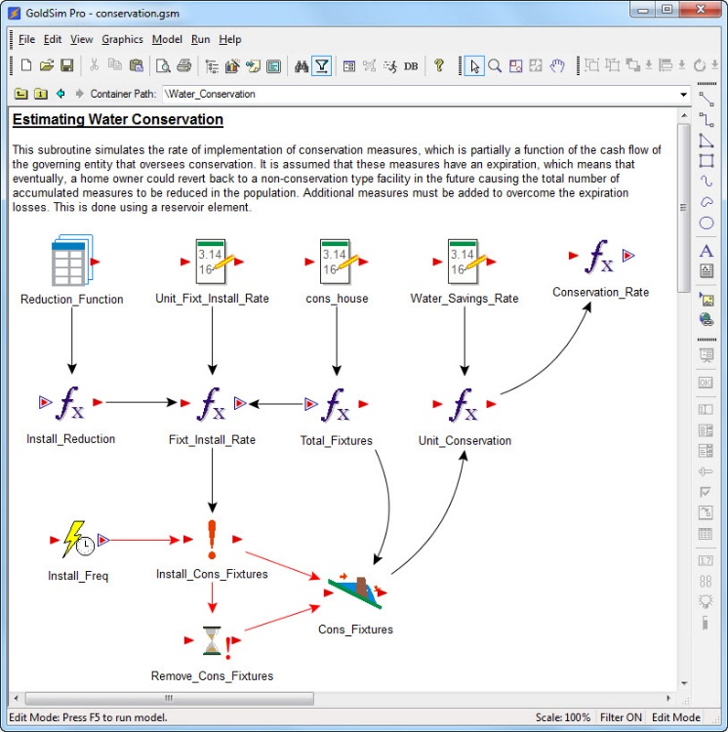
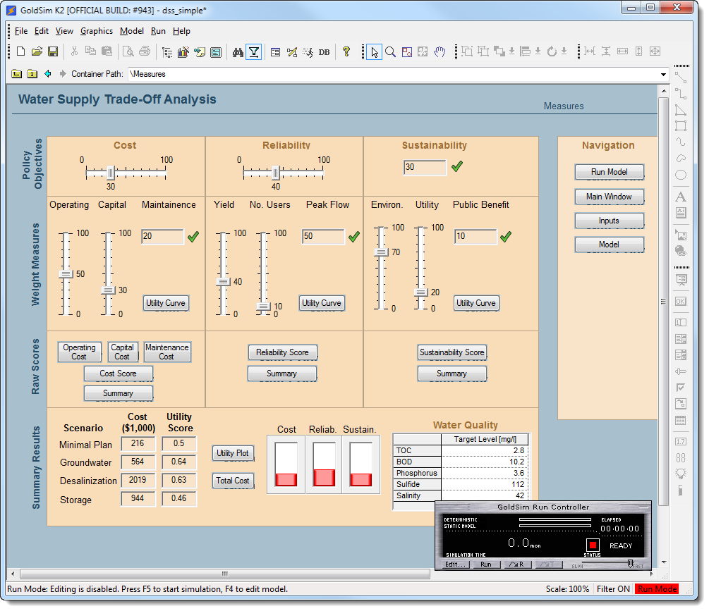
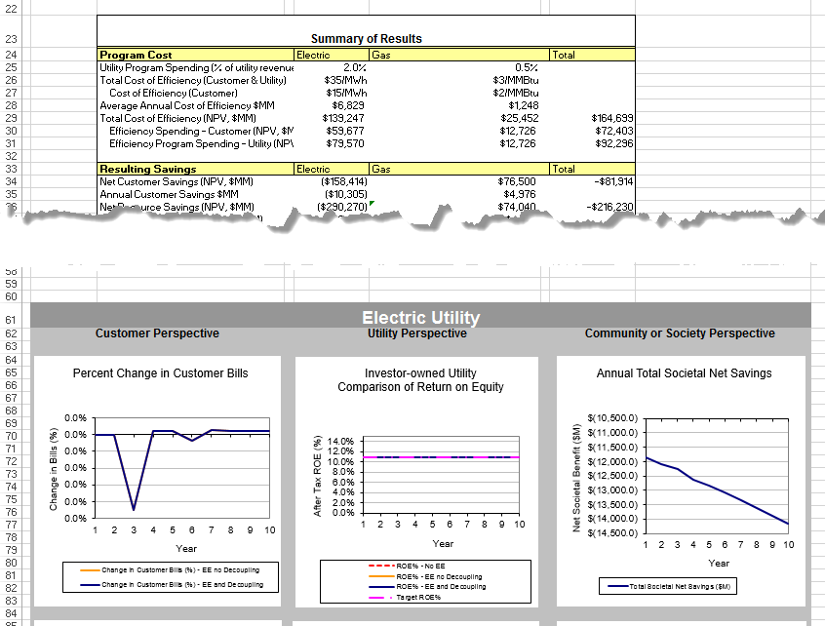
Types of Models
A model to answer a specific question
A tool to answer on-going questions

Slide 4
Model Requirements
Modeling objectives (basis for level of effort)
What does the model do and not do?
Document specific requirements
  Interface and Reporting
  Data
  Functional requirements
  Performance
  Delivery & Maintainability
Do this before designing your model

Slide 5
Formulate Conceptual Model
How to fulfill requirements?
System Representation
  Schematic diagrams
  Focus on clarity
Develop a Basic Framework
  Top down approach

Slide 6


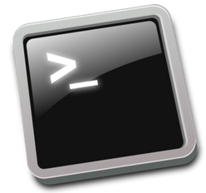

Model Framework
With modeling objectives in mind…
System representation
Performance
Framework
  Input/output
  Interface

Slide 7
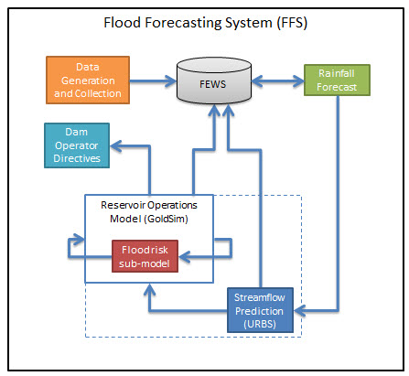
Example: Flood Forecast Model
Image source: Seqwater (www.seqwater.com.au/)

Slide 8
Top Down Approach
Start with
“Here is the problem I’m solving…”
Formulate problem using diagrams and logical statements
How big should new pond be?
Diversion <= 4 m3/d
Can water quality be improved?
Expenses < $5M
Supplies >= 100 ML
How can we maximize supplies?

Slide 9
Draw a System Schematic
Upstream
Overflow
Pond 1
Pond 3
A
Return Flow
Return Flow
Pond 2
Supply A
A
Downstream
S
Supply B

Slide 10
Document the Design
Include requirements
Criteria and assumptions
Diagrams
Basis for model documentation

Slide 11
Implementation
Build using “top-down” approach
Testing
Documentation and graphical design
User interface
Standards
Versioning and file management

Slide 12
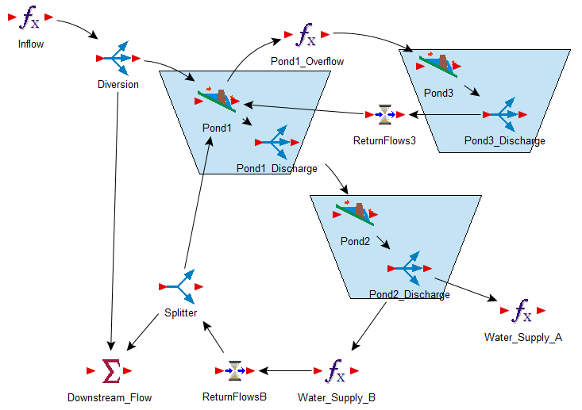
System Components

Slide 13
Keep it DRY
Don’t Repeat Yourself
Local containers provide local scope
Cloned containers
Maintain libraries

Slide 14
Group Elements with Common Purpose
Scenario data
Data controlled by dashboard
External data sources
Logic flow and/or physical flows
Results that export

Slide 15
Containers
Hierarchy
Encapsulate (not hide) functionality
Modular design (reusable)
  Redundant inputs and outputs
Localization
Examples of various types

Slide 16
Types of Containers
Global scope
Localized scope
Subsystem
Local Subsystem
Conditional
Internal Clock
Looping
Conditional, Clock
Conditional Looping

Slide 17
Simulation Settings
Assume the settings will change
Don’t structure expressions on single time setting

Slide 18




Implementation: Build Data Model
Global inputs
Avoid embedding data in expression fields
Main outputs
Import/export

Slide 19
Generic Objects
Localized containers with local scope
Switch out “chunks” of the model
Concise names

Slide 20
Standardize
Naming conventions
Influence lines
Documentation
File Management
Versioning

Slide 21
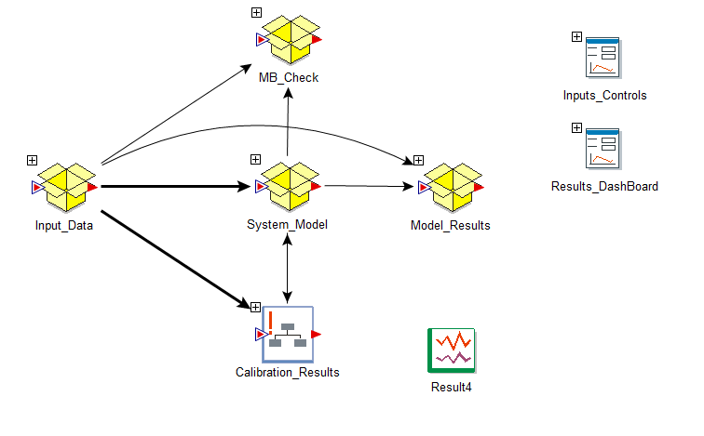
Model Framework Example

Slide 22
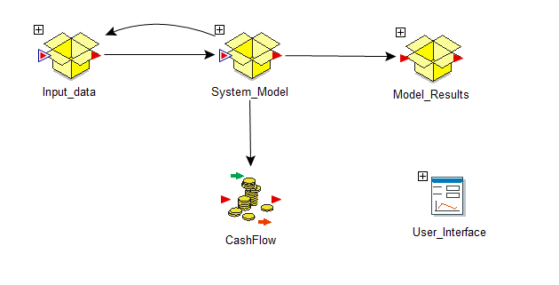
Model Framework Example

Slide 23
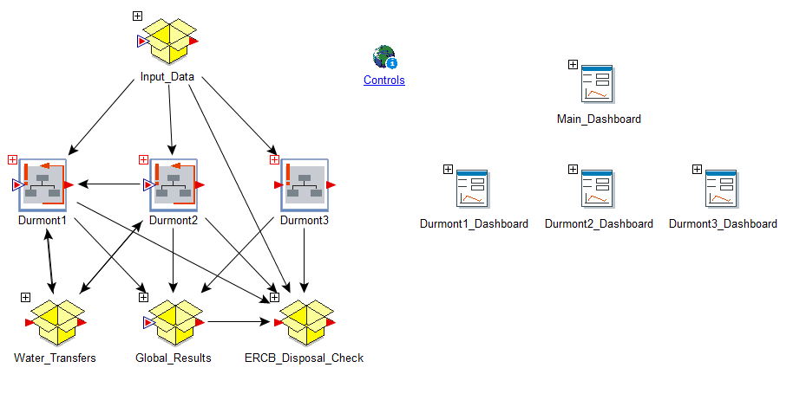
Model Framework Example

Slide 24
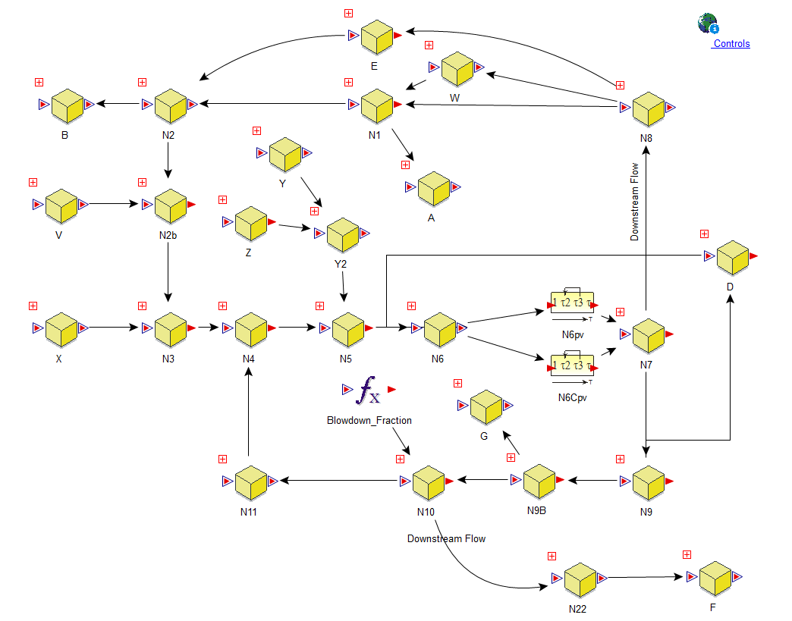
System Representation

Slide 25
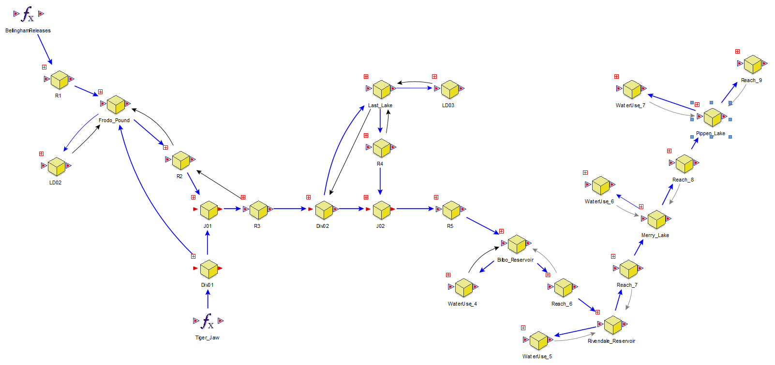
System Representation

Slide 26
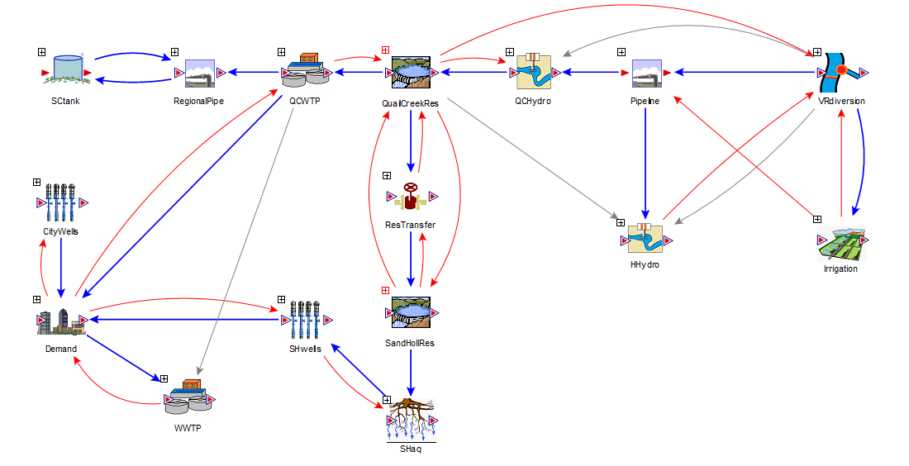
System Representation

Slide 27
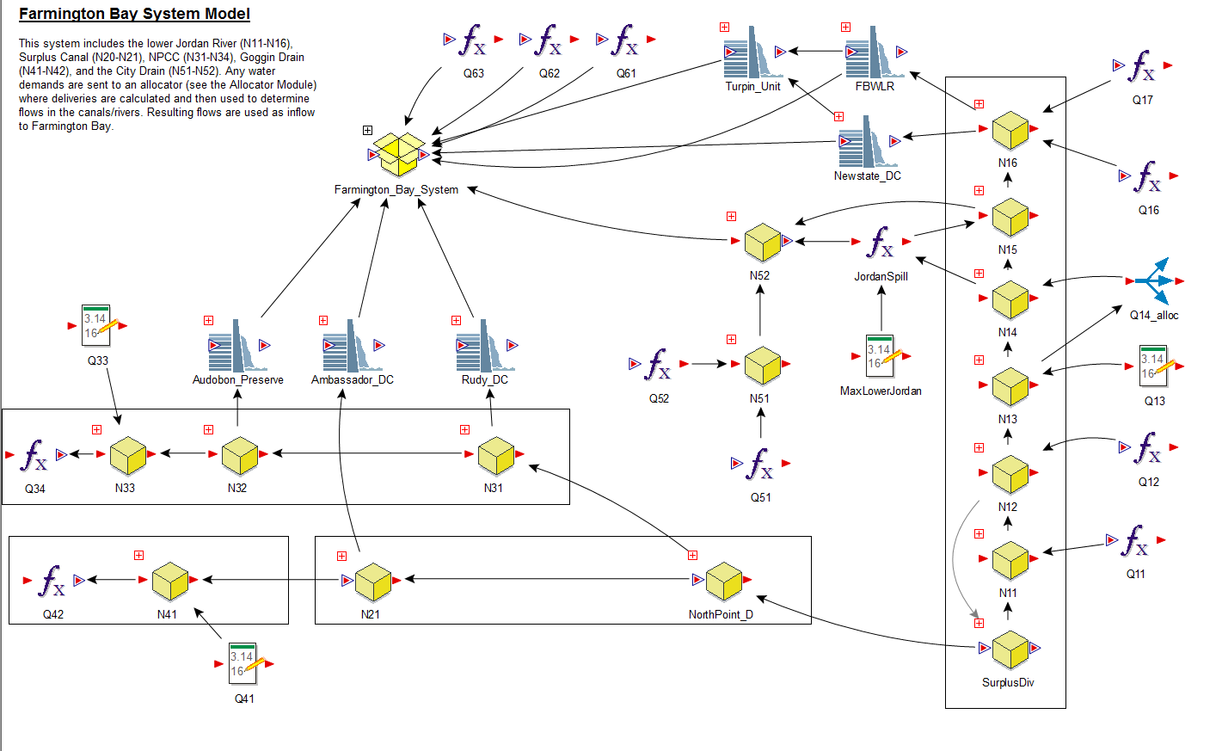
System Representation

Slide 28
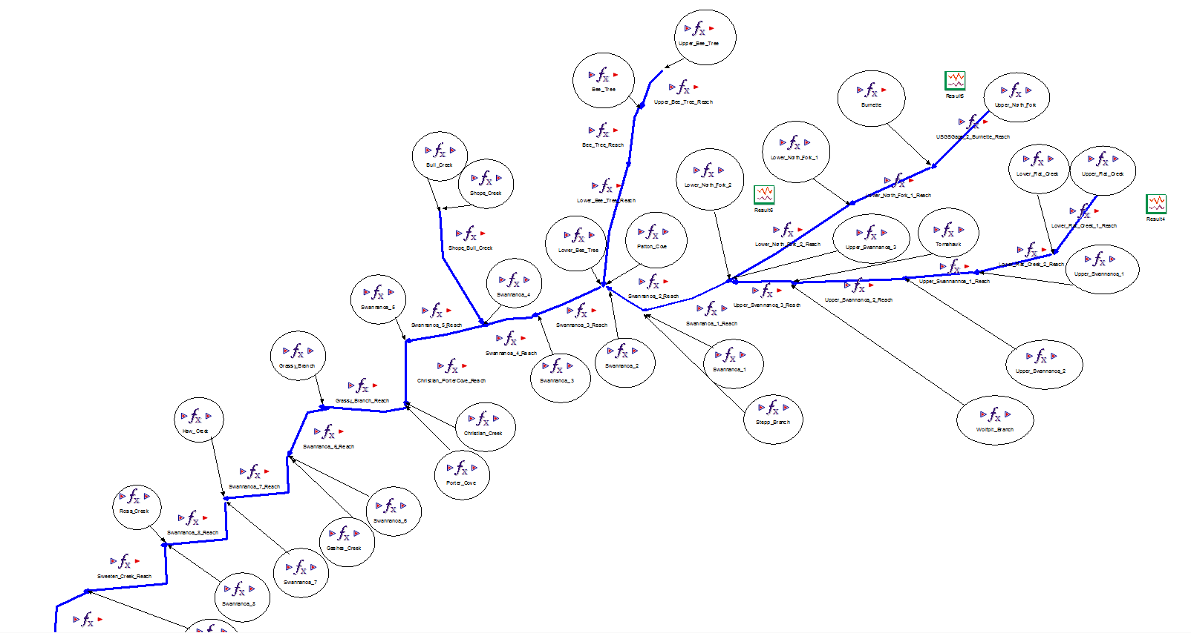
System Representation

Slide 29
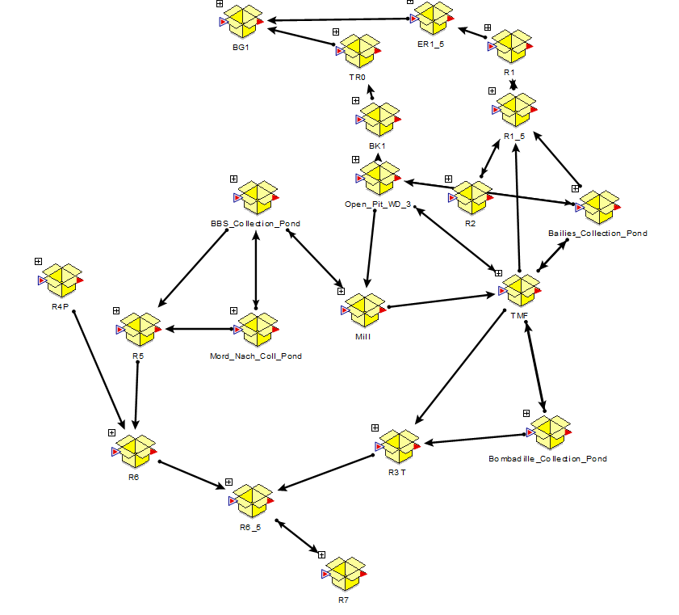
System Representation

Slide 30
Model Documentation
Focus on needs of audience
Text
Graphic objects
Hyperlinks

Slide 31
What Prevents Good Documentation?
Insufficient funds
It is difficult and time consuming to translate model logic and formulation to written descriptions
The person writing the logic might not have the patience or ability to assist with documentation
Lacking a good example to draw from

Slide 32
Components of Documentation
Abstract/Introduction/Background
The underlying methodology (theory)
Model limitations (and capabilities)
Data requirements
Input specifications (how is data put into the model?)
Summary of model output and any processing of results
Example application of the model

Slide 33
Versioning

Slide 34
Validation
Independent models or algorithms
Excel – note difference in time stepping!
Reporting periods
High-resolution results

Slide 35
Independent Review
Documentation is the basis
Markup the model

Slide 36
Presentation
High level access to important results
Low level access to all other results
Consistency
Muted colors
Dashboards
  Light background for Windows controls

Slide 37
Graphic Design
Fonts
Graphical objects
Colors
Custom images

Slide 38
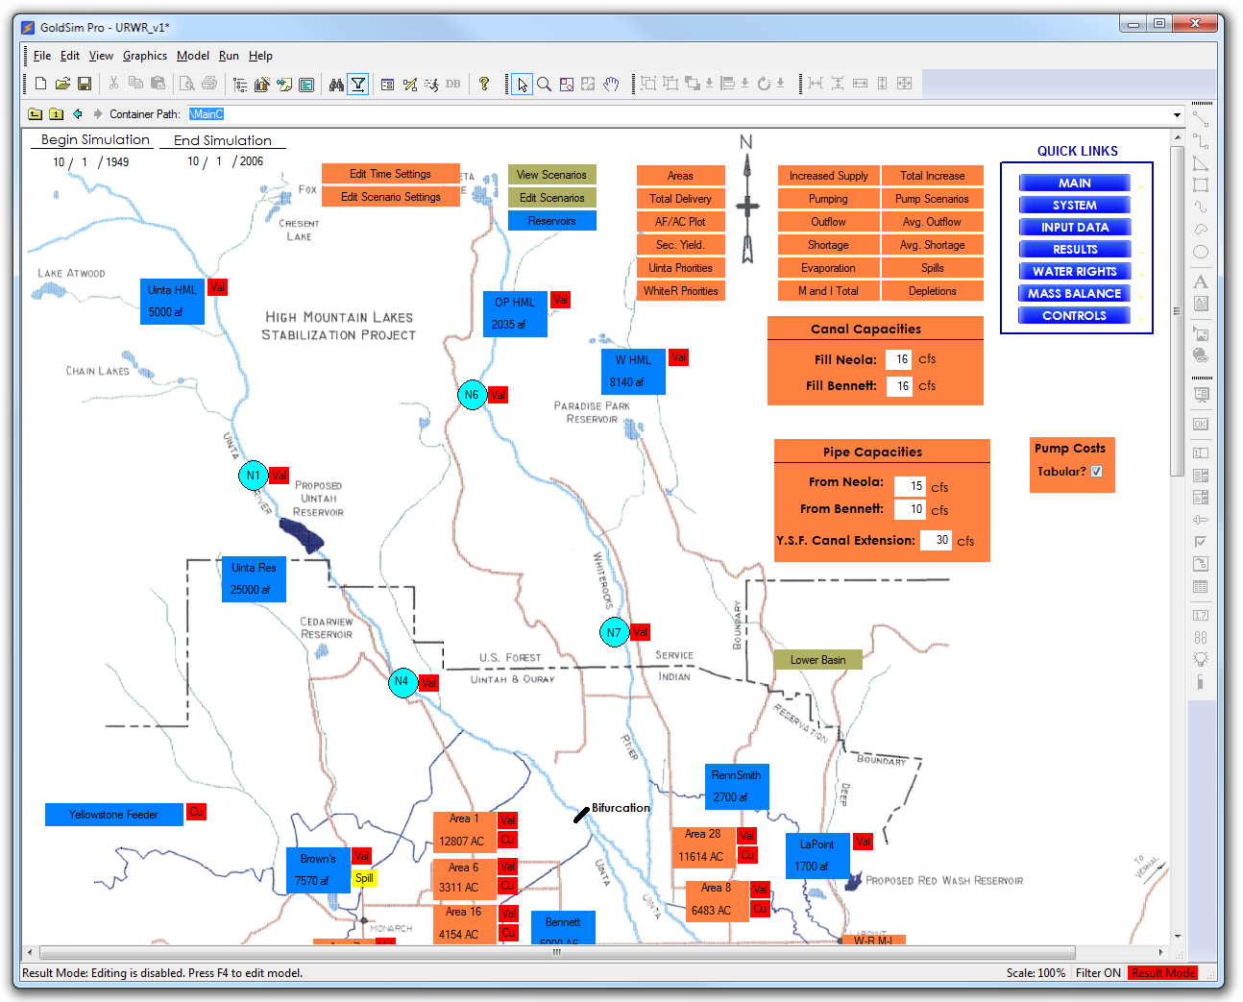

Slide 39
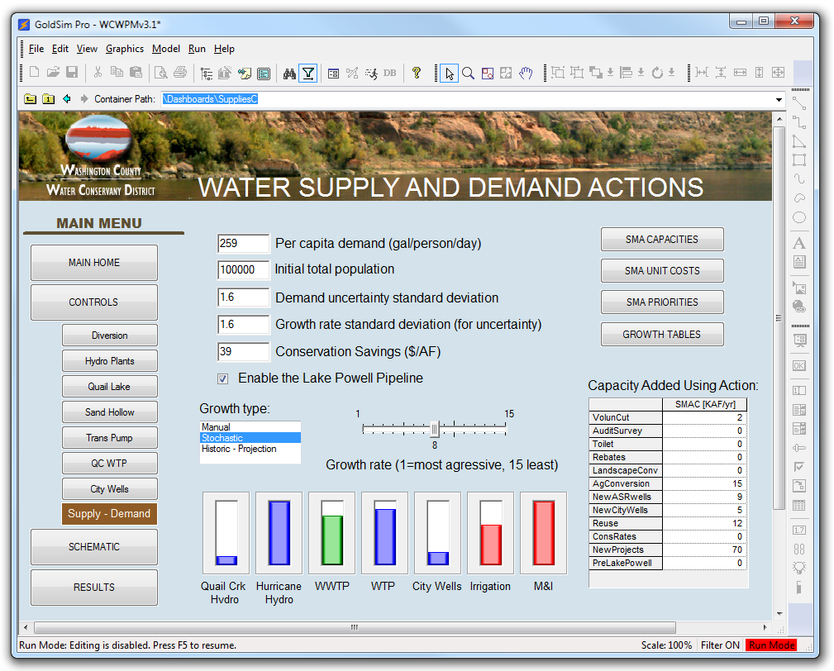

Slide 40
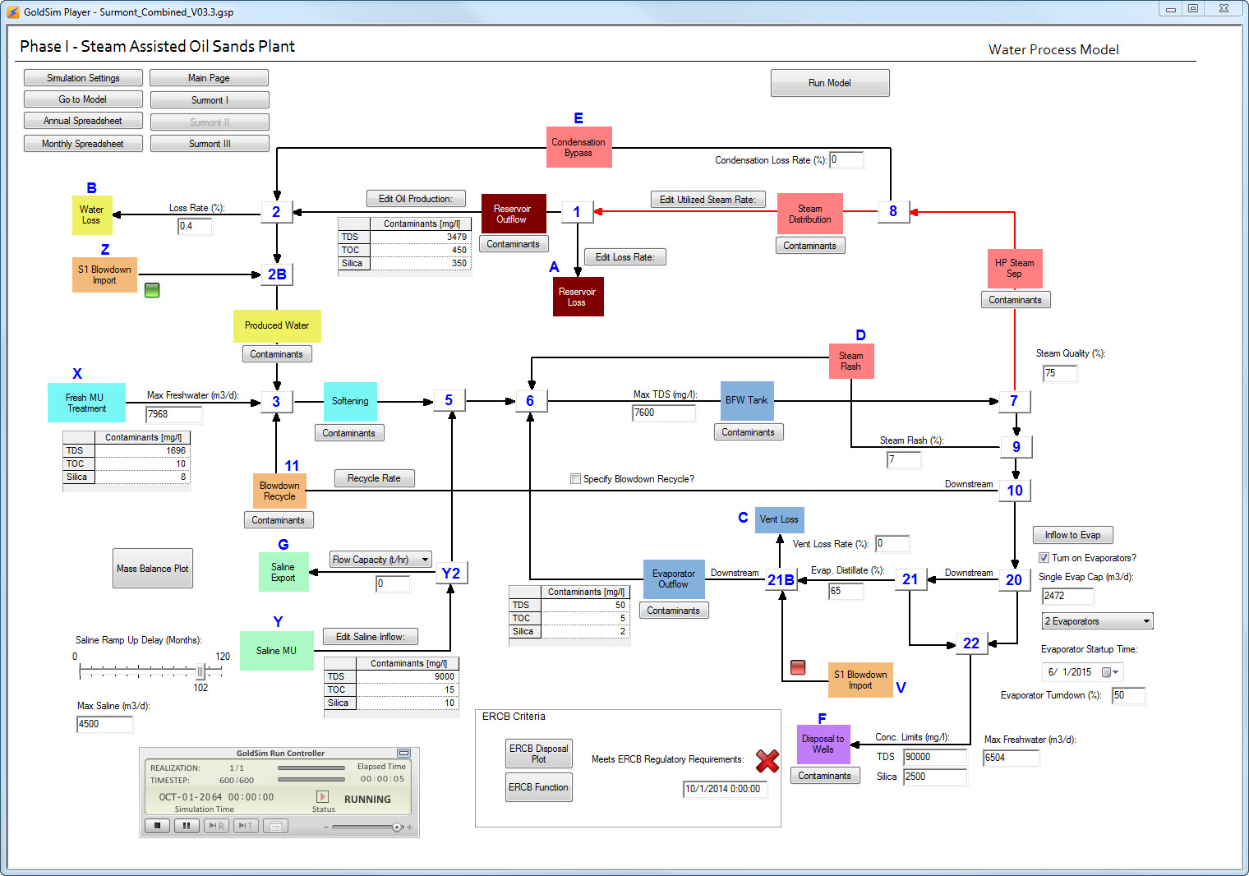

Slide 41
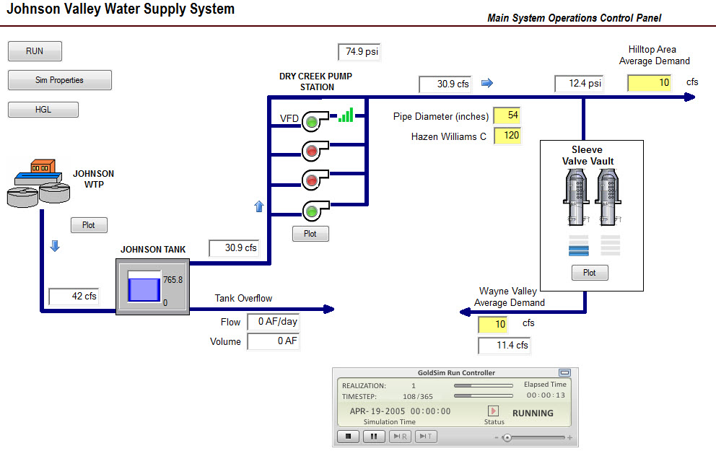

Slide 42
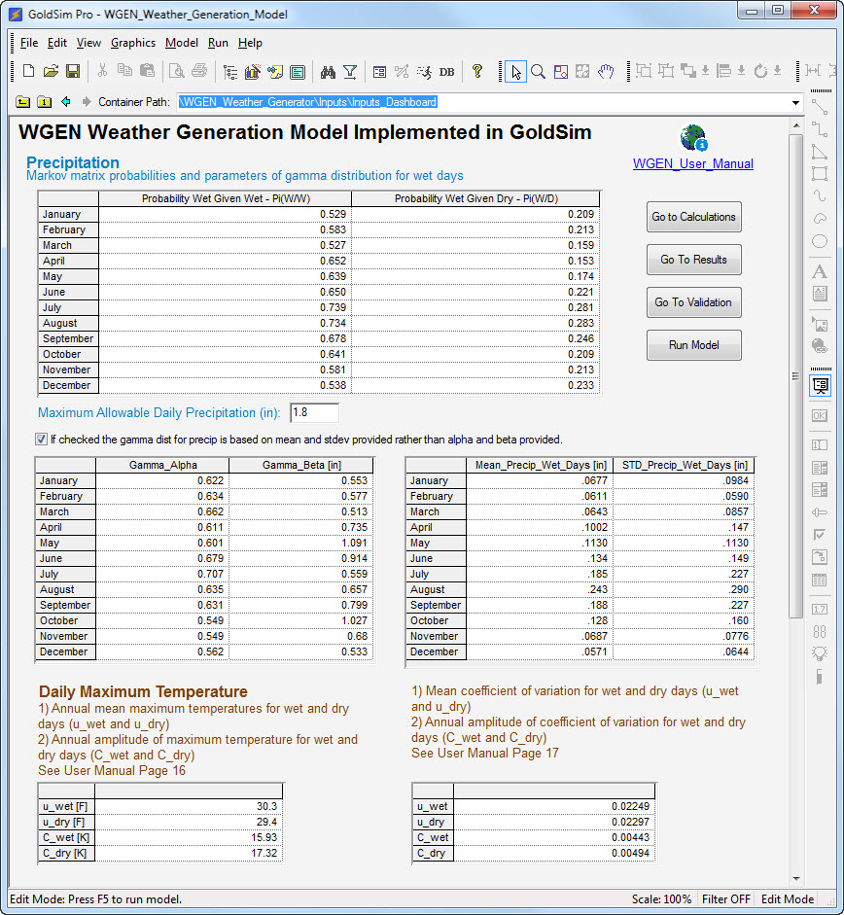

Slide 43
Design Standards
Example document

Slide 44
Model Documentation
Operations
  requirements for basic execution of the runs
Use
  Math theory, data requirements, model processes
Maintenance
  modeling scenarios, maintenance log
Assessment
  assessment, applications, summary, history
Structure

Slide 45
Thank you!

