Slide 1
Basic Discrete Event Modeling in GoldSim
Rick Kossik

Slide 2
Outline
What Do We Mean by Discrete Event Modeling?
Basic Concepts
Generating a Timed Event
Understanding Triggering
Responding to an Event: Causing a Change to a Quantity
Complex Triggering
Tracking the State of a System Using Status and Milestone elements
Using Status Elements for Feedback Control
Delaying Events and Simulating Processes and Queues
Interrupting a Simulation
Advanced Discrete Event Applications

Slide 3
What is Discrete Event Modeling?
Dynamic behavior can be conceptualized in two different ways: continuously or discretely.
Things that move continuously can be thought of as flowing (e.g., water).
Other things move or happen discretely. Examples of this include financial transactions or the movement of items through a factory.
Just because something is considered to flow (like water), it does not mean that all of the dynamics for that system can be treated as being continuous. For example, if water is flowing from one pond to another (via a pump), and the pump suddenly breaks down, that is a “discrete event”, and must be treated in an appropriate manner.
As a result, most real-world systems are best described using a combination of continuous and discrete dynamics (i.e., hybrid systems).

Slide 4
What is Discrete Event Modeling?
You should not confuse GoldSim with Discrete Event Simulators. These highly-specialized tools are designed for simulating processes such as call centers, assembly lines, various types of queues, and shipping facilities.
If the system you are trying to model resembles something like that, a pure discrete event simulator would typically be a more appropriate tool than GoldSim.
Rather, GoldSim is most effective at superimposing “instantaneous” discrete events on continuous systems:
Accidents, failures, sudden events
State changes
Financial transactions

Slide 5
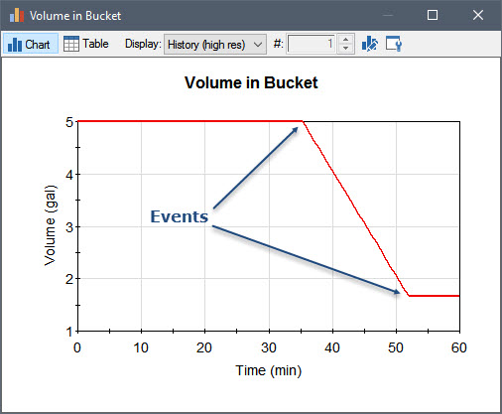
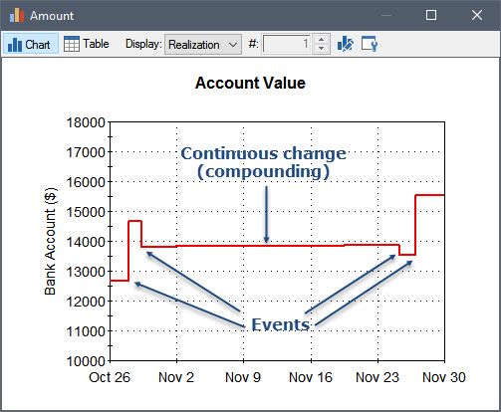
Examples of Discrete Events
Note: Definition of “instantaneous” is relative

Slide 6
Representing Events in GoldSim
You generate events in four different ways:
Based on a specified rate of occurrence, which can be treated as regular or random ("occur exactly once a week" or "occur, on average, once a week");
When a specified condition (e.g., X > Y) becomes true or false;
When a specified output in the model changes; or
At a specified calendar or elapsed time.
Events can then be specified to instantaneously trigger various elements to take a particular action (e.g., instantaneously change their value).

Slide 7
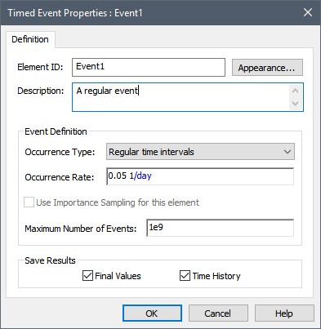
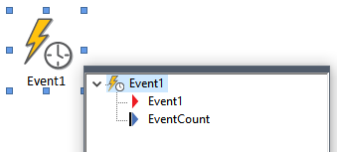
Generating a Timed Event
Let’s create an event that occurs once every 20 days
We use the Timed Event element to do this

Slide 8
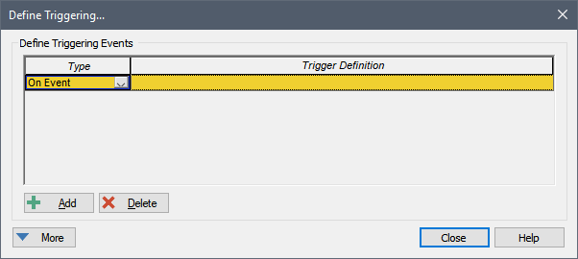
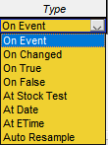
Understanding Triggering
In order for events to be consequential, they must trigger other elements
All elements that can be triggered share the same triggering dialog

Slide 9
Some Simple Triggers
Triggering a Stochastic using a Timed Event
Triggering a Stochastic using a condition
Recall you can generate an event when a specified condition (e.g., X > Y) becomes true or false;
Triggering multiple element simultaneously using a Triggered Event element

Slide 10
Responding to an Event: Changing a Quantity
A variety of GoldSim elements can be triggered by events, with each element responding to the event (taking a particular action) in a different manner.
We just looked at one such element, the Stochastic
One of the most powerful (and common) ways a model can respond to an event is to cause a discrete (i.e., sudden) change to a quantity.
Quantities are state variables
Generally represented by a Stock element (Reservoir, Pool, Integrator)

Slide 11
Changing the Volume in a Pond
Start with a leaky pond
Let’s assume that what we want to simulate is someone adding (instantaneously) 25 m3 of water at 65 days.
What about removing water?
What about “replacing” the current value?
What about multiple changes?

Slide 12
Complex Triggers
Start Time of 1/1/2018, an End Time of 1/1/2019, and a one day timestep.
A pond starts empty and has a constant inflow rate of 1 m3/day.
There is a discrete addition of 60 m3 every month.
There is a discrete withdrawal that occurs randomly once every 50 days, but only in July through December (the withdrawal does not occur January through June).
The amount withdrawn is sampled from a Normal distribution with a Mean of 200 m3 and a Standard Deviation of 40 m3.

Slide 13
Responding to an Event: Changing the State of a System
In many models, the state of the system changes discretely (suddenly) during a simulation in a binary manner:
A piece of equipment fails (i.e., changes its state from operating to failed);
An object (e.g., a pump or a light) turns on or off;
A business opens and closes for the day; and
A task or activity is completed (i.e., it changes from unfinished to finished).
It is useful for the state of the system to then be referenced by other elements
To support this, GoldSim provides two elements that can be used to track the state of the system: the Status element and the Milestone element.
Both of these elements can respond to discrete signals.

Slide 14
Status Element
Simulate a conveyor belt that moves soil from one location to another, where it is subsequently stockpiled.
The conveyor belt is modeled using a Material Delay. The stockpile at the end of the conveyor belt is a Reservoir.
When the conveyor belt is operating, it moves at a constant rate and is loaded at a contant rate.
The conveyor belt, however, only operates from 8AM to 5PM. Outside of that time, the conveyor belt stops (and is no longer loaded).
The model uses a Status element to track the state of the conveyor belt (on or off).

Slide 15
Milestone Element
We want to record when the stockpile gets to a certain size (e.g., 20,000 kg). Moreover, at that point we want to shut down the entire process.
We will use a Milestone element to represent this.

Slide 16
Using Status Elements for Feedback Control
Status elements can be used to properly model a feedback control system
In the absence of Status elements, it is common to see models that result in (unrealistic) oscillations
Let’s experiment with a simple example:
A pond starts empty
Stochastic Inflow represented by a truncated Normal, with Mean 100 m3/day, SD of 50 m3/day, Min of 0 m3/day (changes hourly)
We want to try to keep the volume at 300 m3 by using a pump that operates at 200 m3/day
What should our logic be for turning on and off the pump?

Slide 17
Using Status Elements for Feedback Control (cont.)
This is not representative of how a real feedback control system would typically work.
As an analogy, consider a thermostat:
A thermostat monitors the temperature (a proxy for the heat in the house, which is the state variable)
The heat does not turn on when temperature exceeds X and turn off when it drops below X
Rather, it uses a deadband

Slide 18
Using Status Elements for Feedback Control (cont.)
Turn the heat on when the temperature reaches 68; turn it off when it reaches 70
The thermostat monitors two things: temperature and Is system on?
Pond example: turn the pump on when the volume reaches 310 m3, turn it off when it reaches 290 m3
To do this, we actually need to track two state variables
Volume and Pump State (On or Off)
Heat off
Heat off
Heat off
70
68
Heat on
Heat on
Heat on

Slide 19
Delaying Events and Simulating Processes and Queues
In some cases, we will want to delay discrete signals in order to realistically represent a system. In particular, we can use Event Delays to model a “process”.
The term “process” here to mean something that operates on a discrete item or instance, and takes a specified amount of time to complete:
moving a widget through a machine (that operates on or processes it in some way)
transporting an item from one location to another
As a general rule, GoldSim was not specifically designed to do this (other tools are specifically designed to model things like this), but it can sometimes be useful to do so.

Slide 20
Modeling Processes and Queues
Let’s model the security checkpoint at the airport
Model 1:
People arrive at the checkpoint
The number of stations changes depending on the number of people in line
Model 2:
Add “fast line” to where x% of arrivals are randomly routed
Model 3:
Airport has two checkpoints
People are directed to whatever checkpoint has the shortest line

Slide 21
Interrupting a Simulation
The Interrupt element is another element that can be triggered by events. However, it is not used to actually represent a feature or a process in a model. Rather, it is used to help you debug and test complex models as you build them.
The Interrupt element is triggered by an event, and responds by interrupting the simulation.
When the simulation is interrupted, you can display a user-defined message dialog with options for continuing or pausing (and subsequently aborting) the simulation and/or you can specify that the message is written to the run log.

Slide 22
Why Use an Interrupt?
To alert you to error conditions that indicate a logical problem in a model. For example, if a certain variable should not go below 0 (if it does, it indicates a logic error in the model), you could use an Interrupt element to check for this condition.
To help you debug a model that is producing a fatal error or showing unusual behavior. For example, if a model produces a fatal error (or starts behaving unusually) when certain conditions are met or at a particular time in a simulation, you could use an Interrupt element to pause the simulation at that point so that you can browse the model and/or save the results up to that point in time.
To terminate (skip to the end of) a simulation when a certain set of conditions are met. For example, if you were carrying out a Monte Carlo simulation of a project, the project may actually complete at a different time each realization. When the project completes, you could use an Interrupt element to skip to the end of the realization.

Slide 23
Advanced Discrete Event Applications
Modeling failures using the Reliability Module
Relies heavily on discrete event modeling, since failures (and repairs) are sudden events.
Modeling Projects using Conditional Containers
Containers are turned on and off via events

Slide 24
Learn More
Model Library
Past Webinars
Modeling Projects (May 2015)
Introduction to Reliability Module (May 2017)
Contact us with questions
support@goldsim.com

